Slide 1
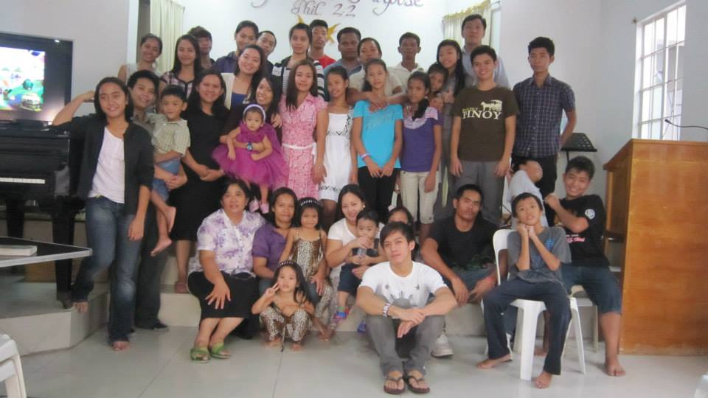
Valenjula chapter in the Philippines

Slide 2
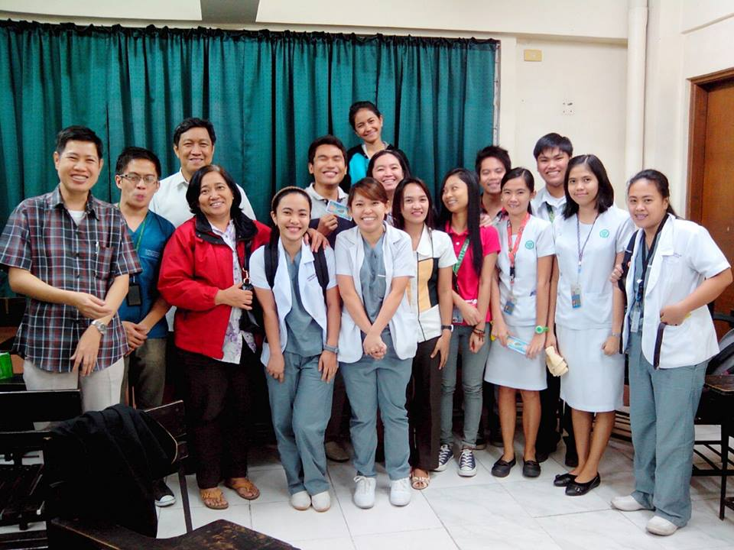
Valenzuela chapter in the Philippines

Slide 3
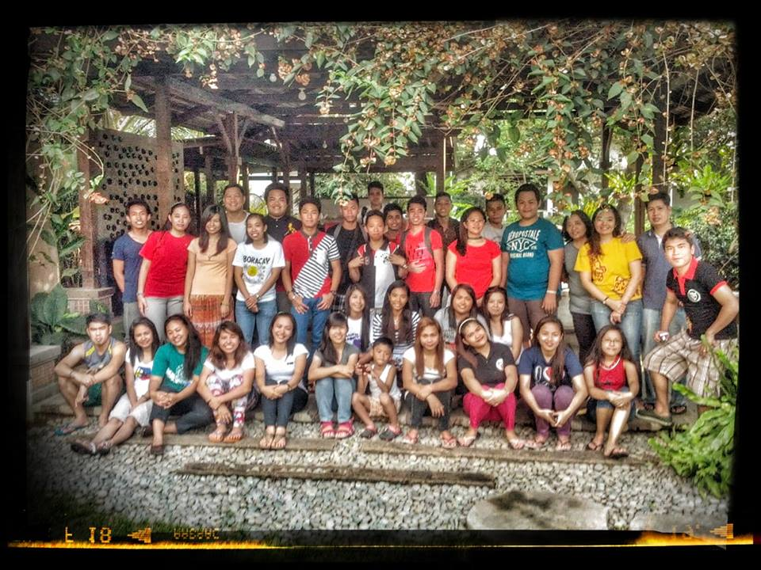
Valenzuela chapter in the Philippines

Slide 4
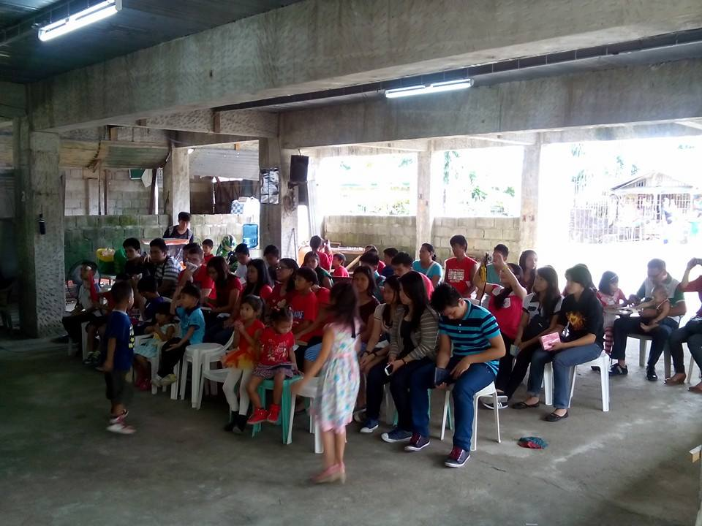
Antipolo chapter in the Philippines

Slide 5
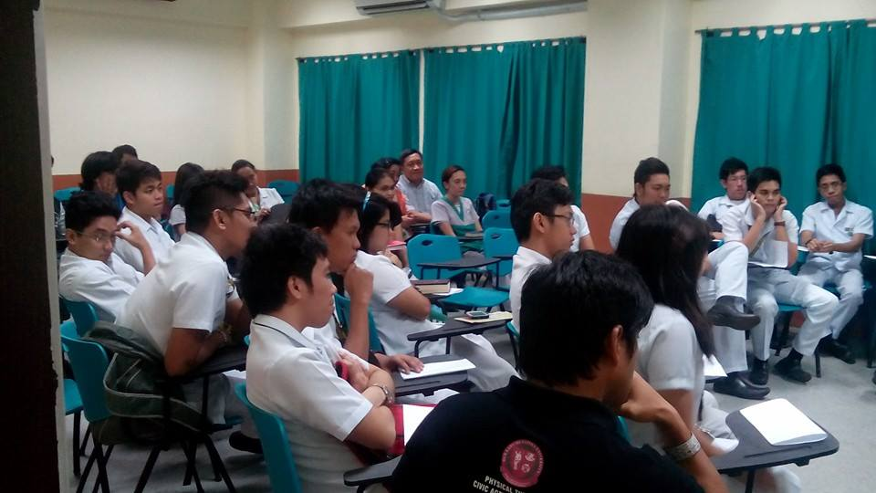
Antipolo chapter in the Philippines

Slide 6
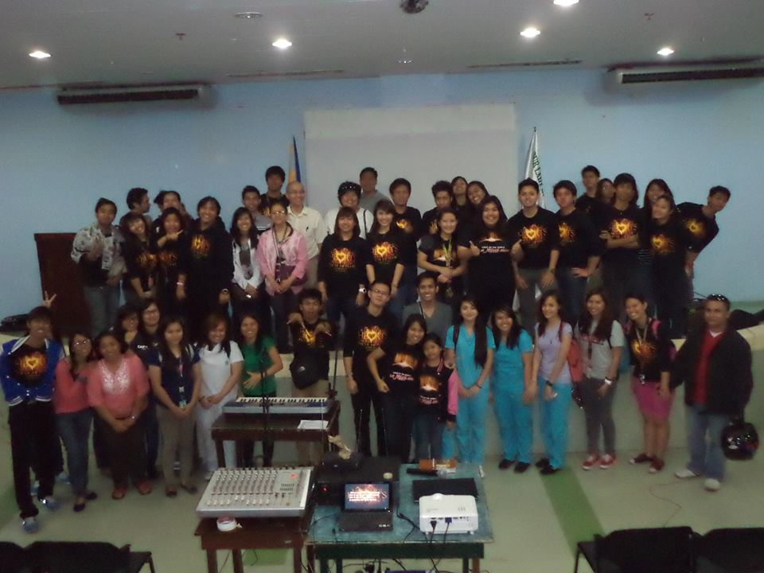
Antipolo chapter in the Philippines

Slide 7
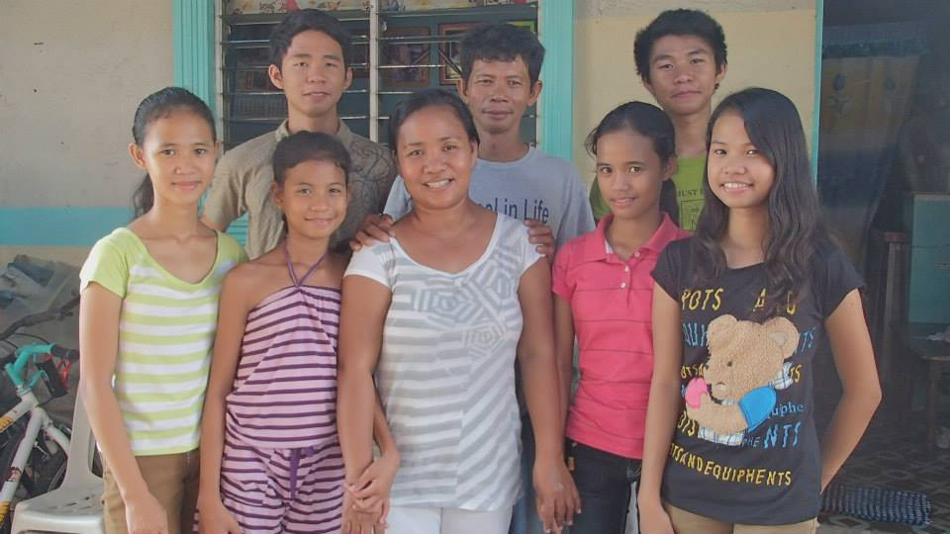
Bulacan chapter in the Philippines

Slide 8
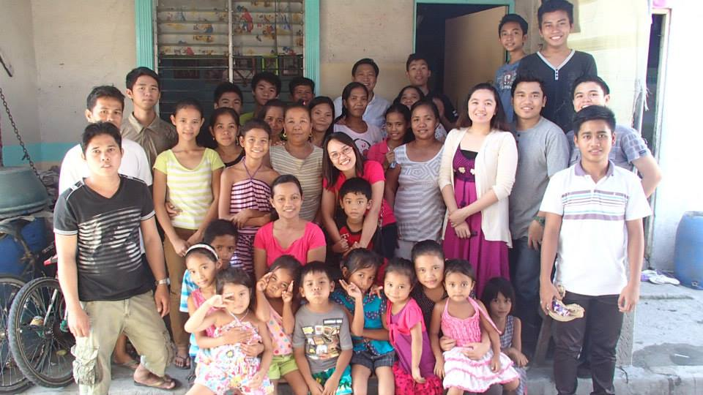
Bulacan chapter in the Philippines

Slide 9
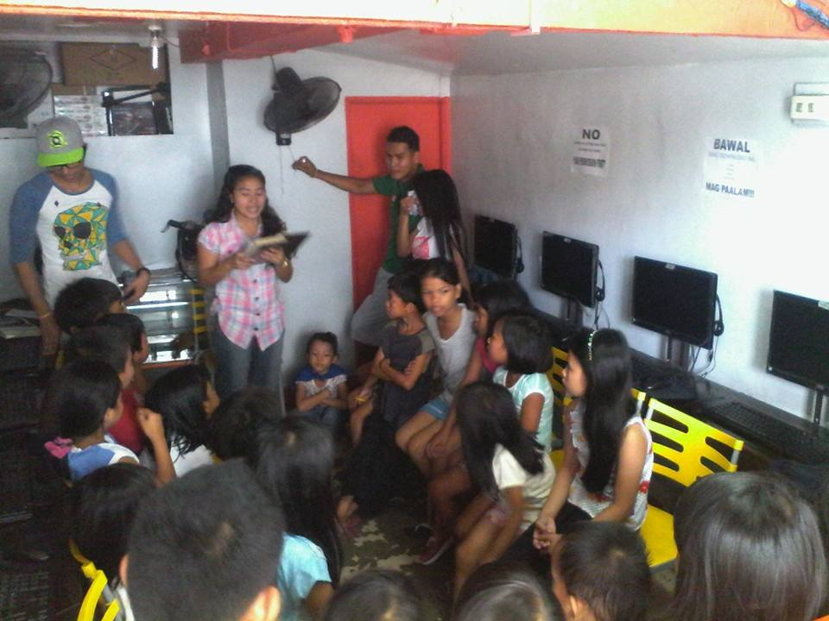
Bulacan chapter in the Philippines

Slide 10
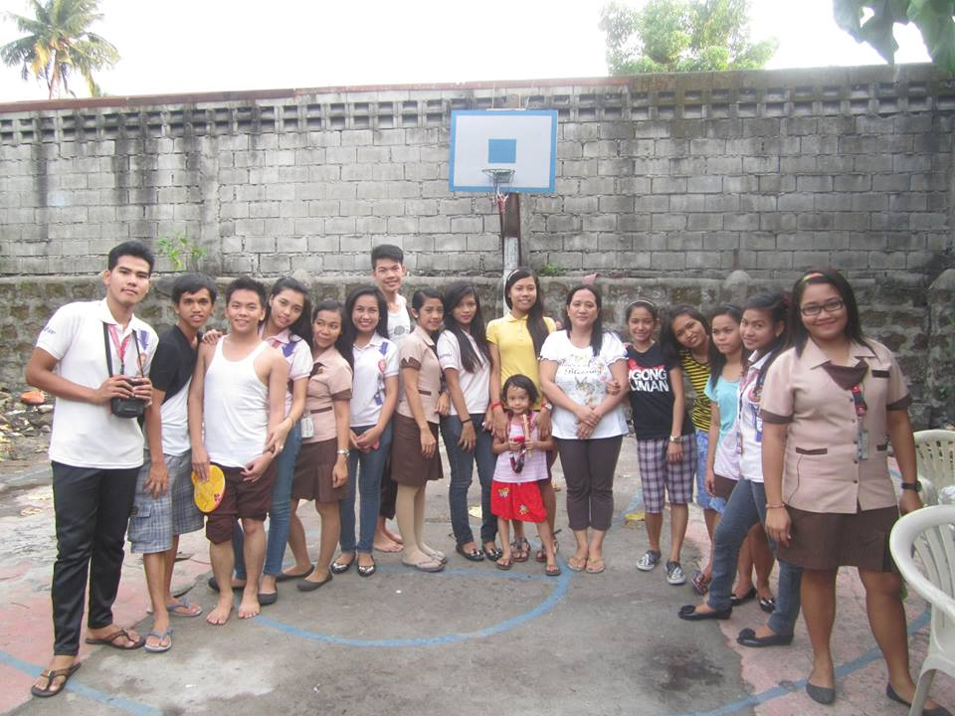
Calooncan chapter in the Philippines

Slide 11
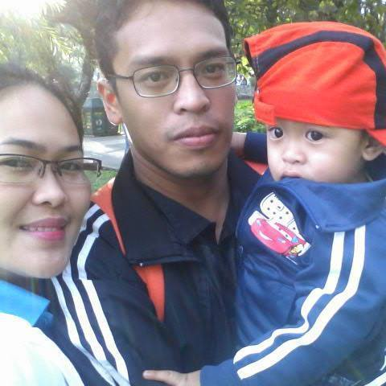
Madella Qurino chapter in the Philippines

Slide 12
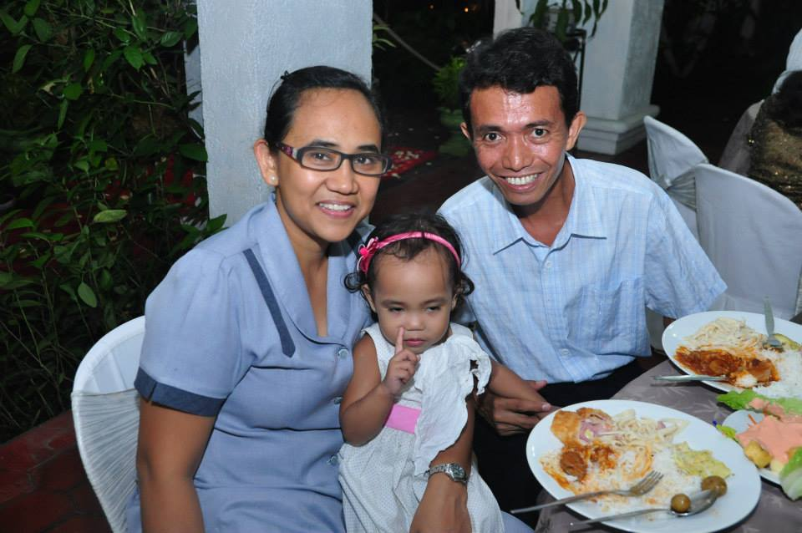
University belt chapter in the Philippines

Slide 13
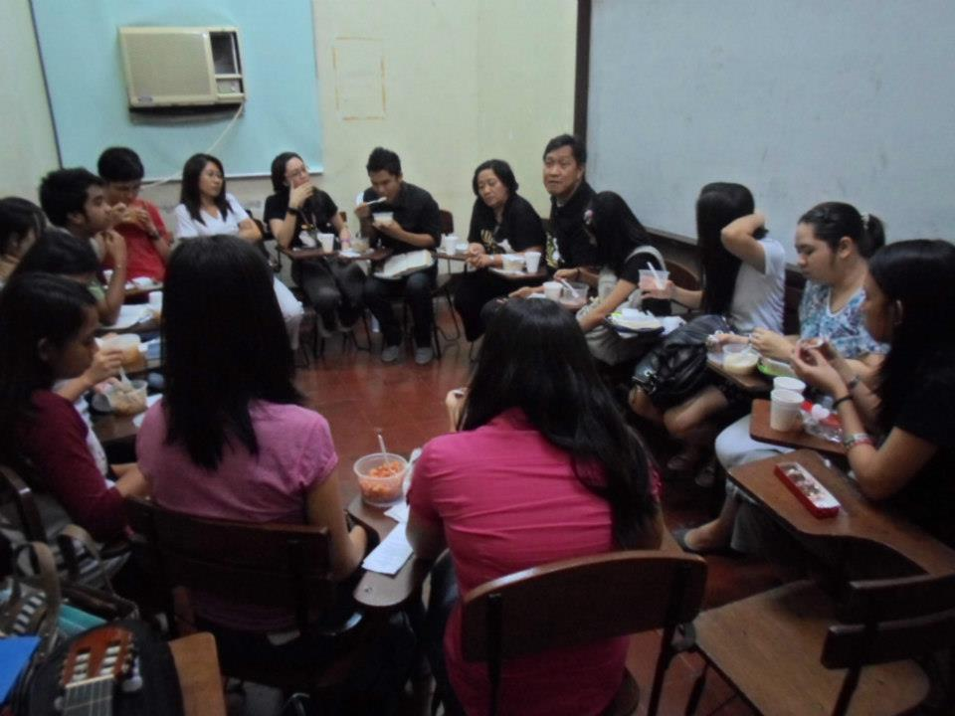
UP Manila chapter in the Philippines

Slide 14
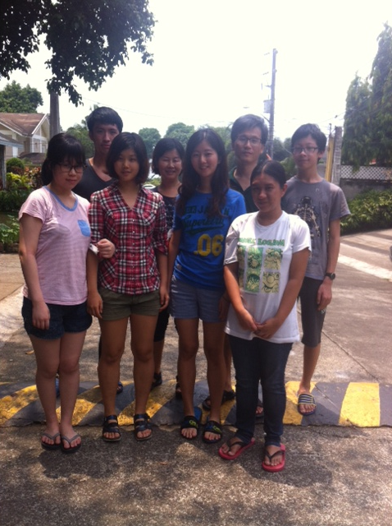
The Quezon chapter (UP quezon) in the Philippines
Bible conference on April 2014

Slide 15
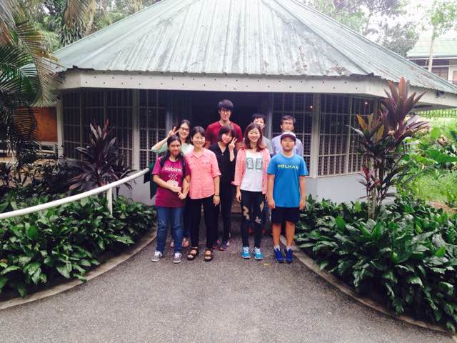
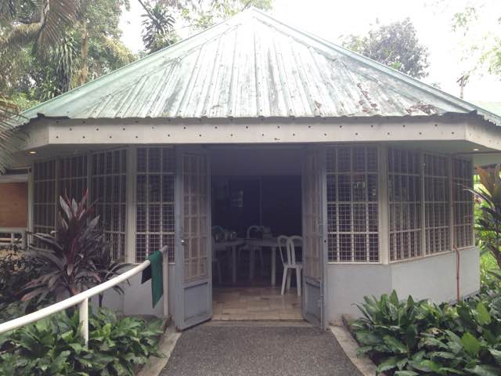
The Quezon chapter (UP quezon) in the Philippines
Worship service at new center in Campus on Nov 2014

Slide 16
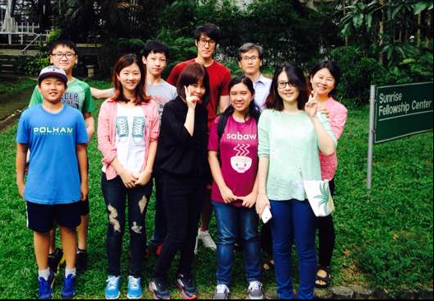
The Quezon chapter (UP quezon) in the Philippines
Worship service at new center in Campus

