Slide 1
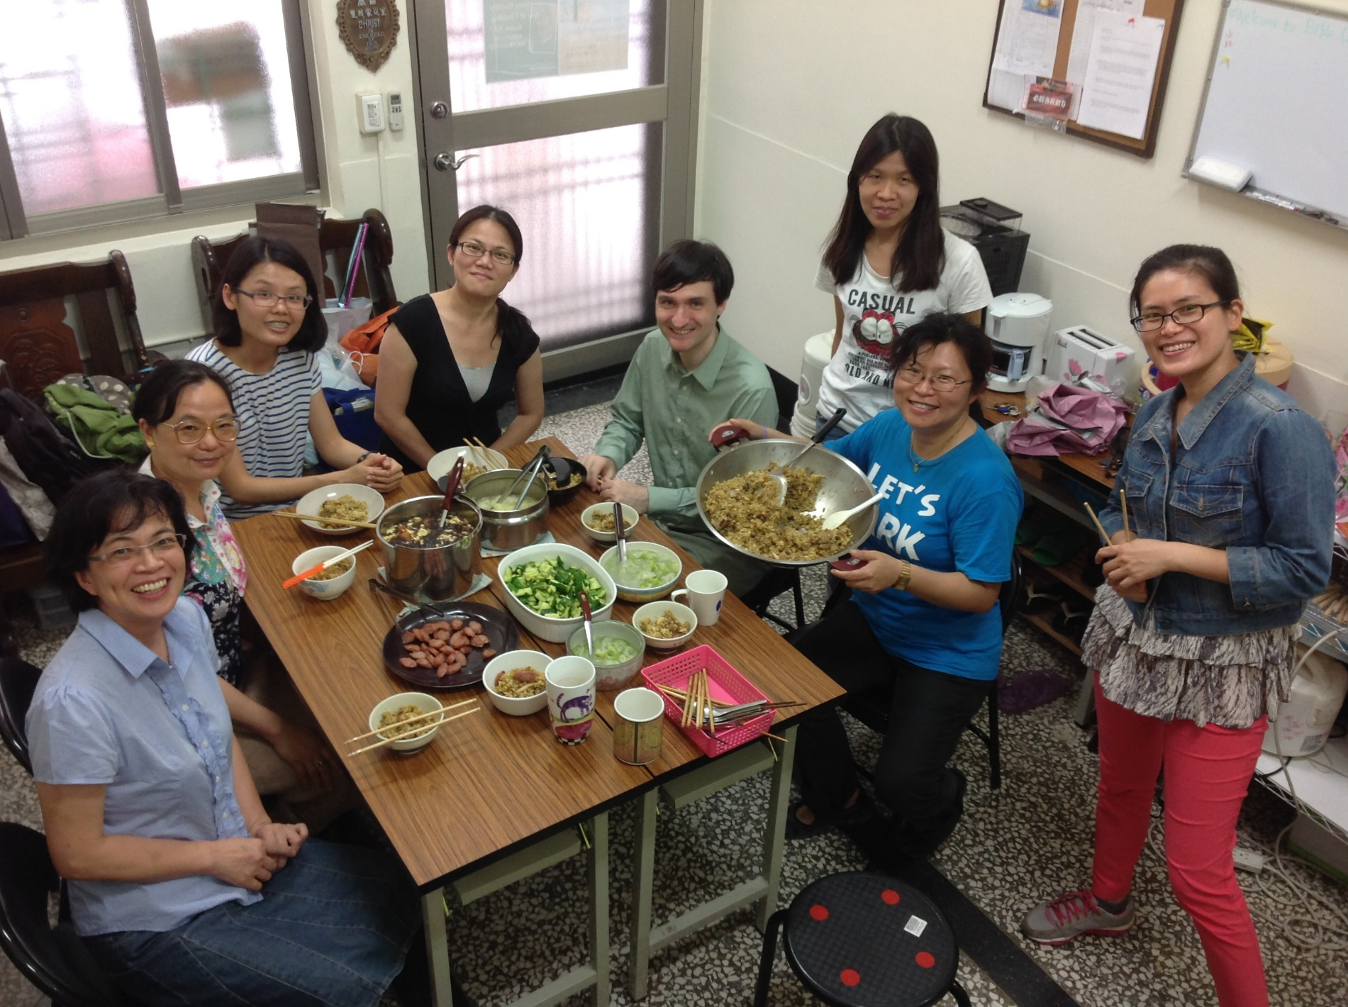
Taiwan UBF, Kaohsiung chapter yearly report
2014

Slide 2
Our 2014 Key Verse was
“Be strong and very courageous. Be careful to obey all the law my servant Moses gave you; do not turn from it to the right or to the left, that you may be successful wherever you go.” ( Joshua 1:7 )

Slide 3
We chose this key verse for last year, because our ministry was going through transition, including some members going overseas. We wanted to remember how we can be strong and courageous wherever we go.
At the beginning of Joshua, Israel was also going through transition. God’s direction for Joshua was to be strong and courageous, but his direction was also to obey the law. Joshua needed strength not just to fight against the Canaanites, but also to fight the spiritual battle to do what is right. If he would remain faithful, then God would be faithful to him, and would give him success wherever he went.

Slide 4
2014 Review
You will be successful wherever you go
This year, many of our members went many places...

Slide 5
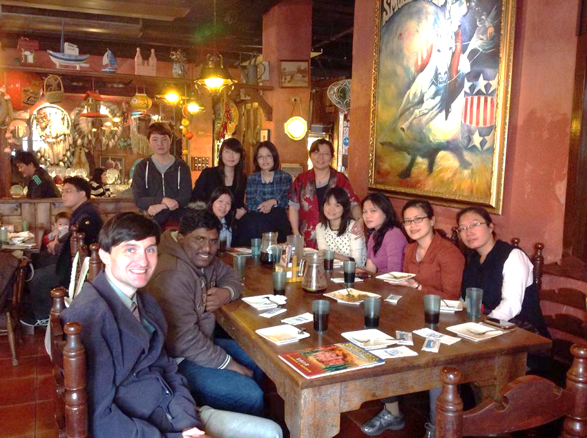
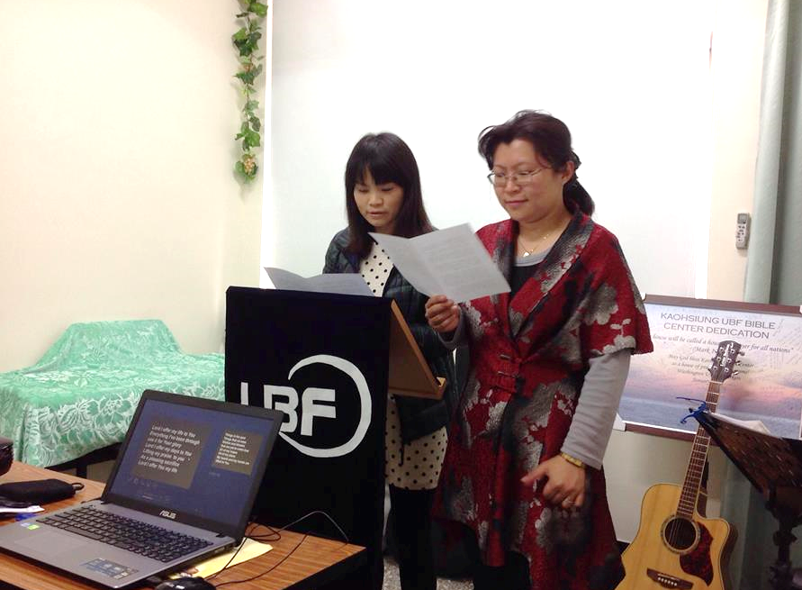
Jenny’s going away
In February, Jenny moved to Taipei after being with us for 5 years. We sent her out with a prayer to encourage the Taipei ministry and with a prayer for reaching the people in northern Taiwan.

Slide 6
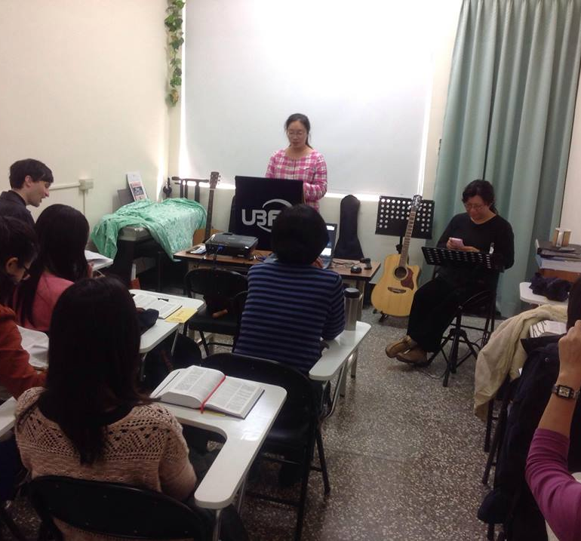
In March Shepherdess Naomi had a chance for 1-year overseas study at the University of Delaware. She has been attending the Baltimore and Washington ministries.
Naomi’s going away

Slide 7
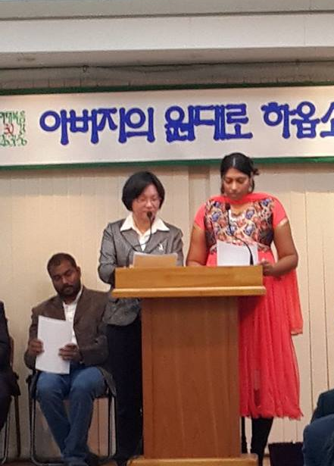
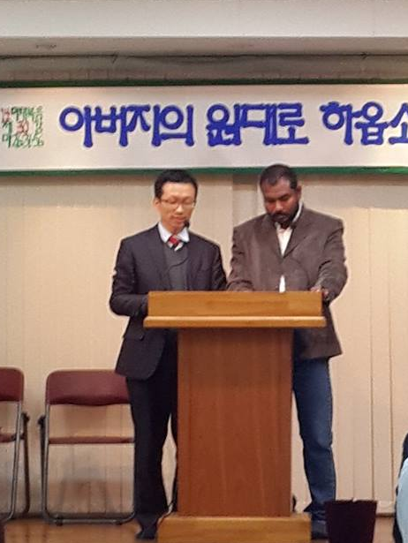
Dr. Matthew and Dr. Judy in Yonhee center - testimony sharing
In August, Judy and Matthew (who had returned to India after several years in our ministry) received research professorships in Korea. They have been attending Yonhee service.

Slide 8
It is unexpected and it is too-much-of-a-coincidence that people would go out to these specific places which have been supporting our ministry so much in prayer.

Slide 9
Also last year, one of our younger Bible students went to Indonesia for work. She attends the ministry there. I was also surprised to learn that she encouraged her sister who began attending Tokyo ministry.

Slide 10
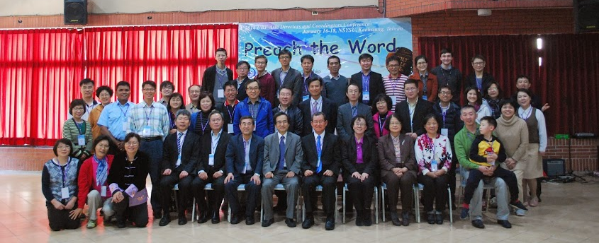
2. Growing through Serving
Last year began with our hosting of the Asia Director’s Conference.

Slide 11
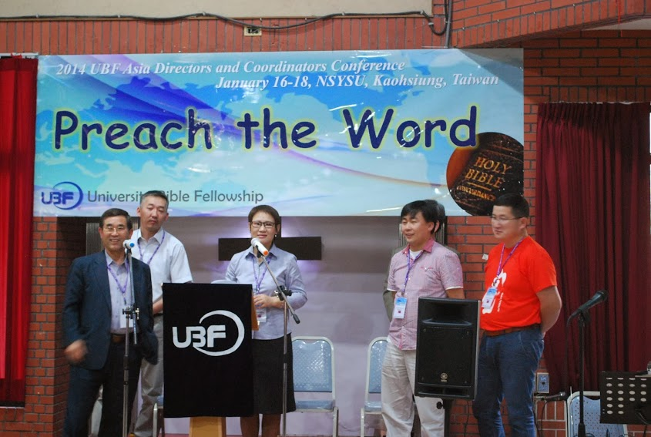
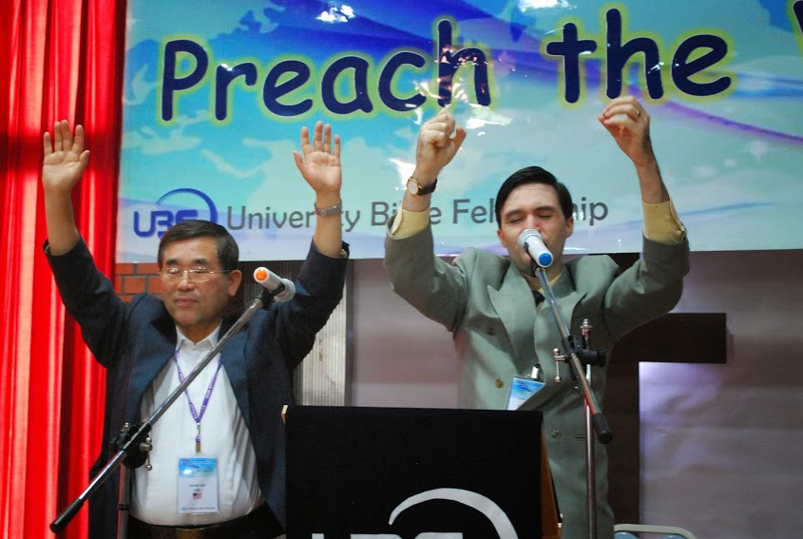
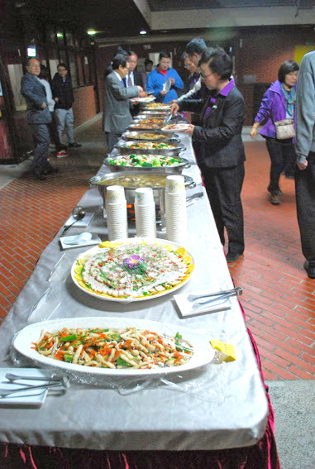
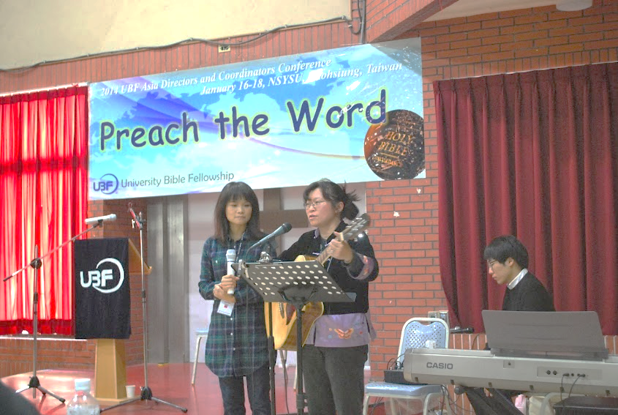
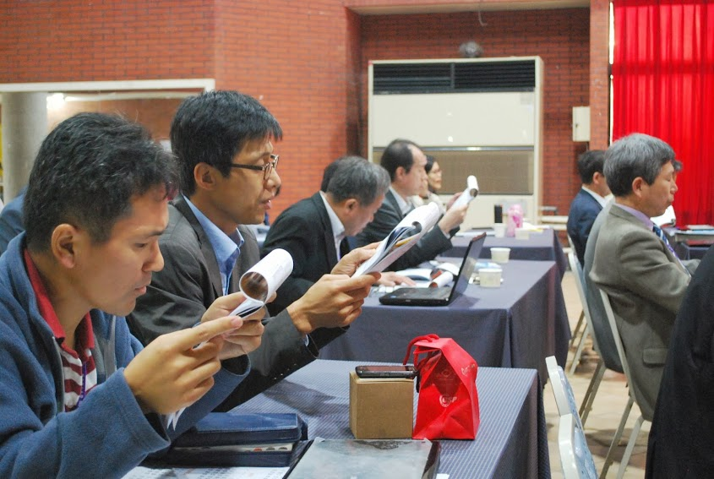
All fellowship members served in many ways. By the end, everyone was tired. But also, everyone had a positive experience.

Slide 12
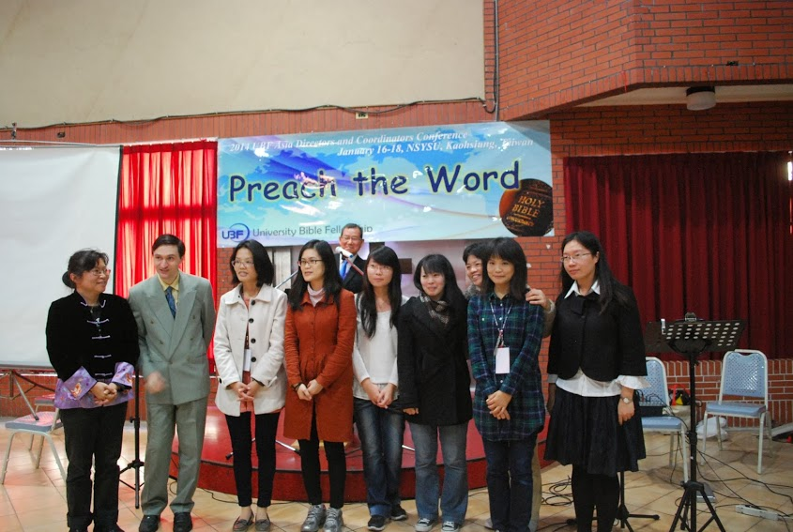
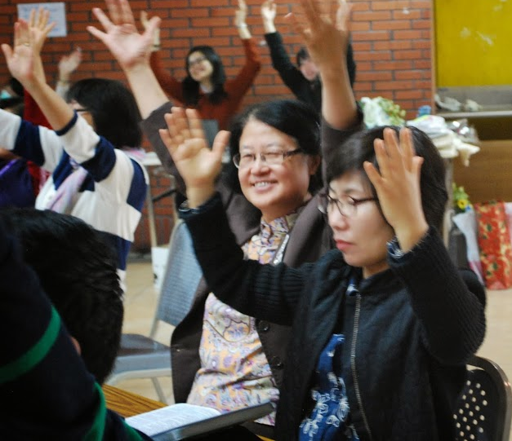
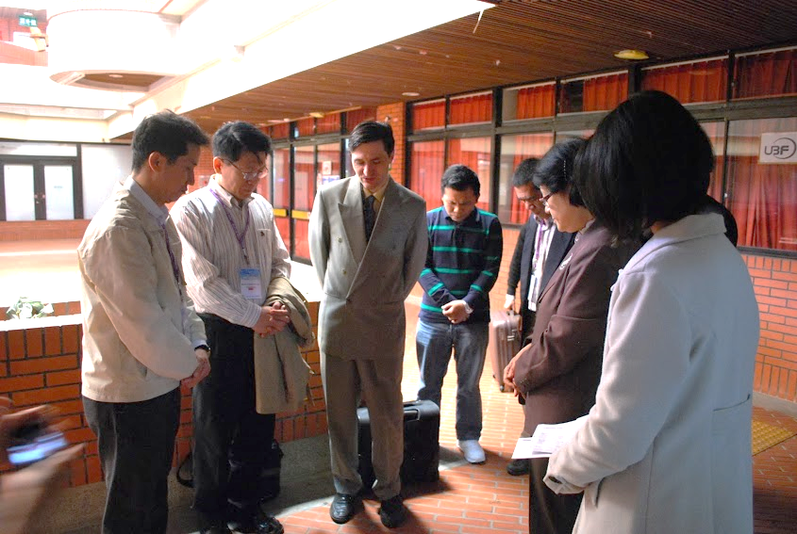
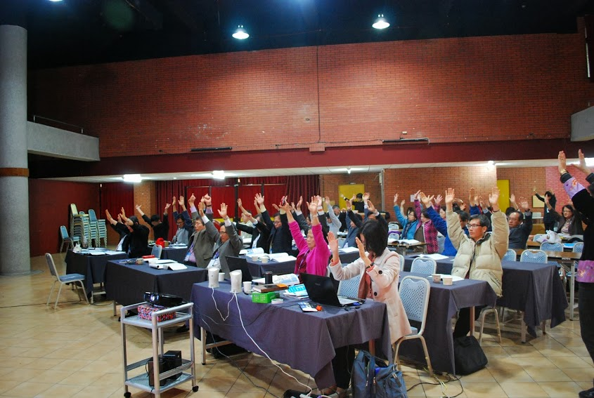
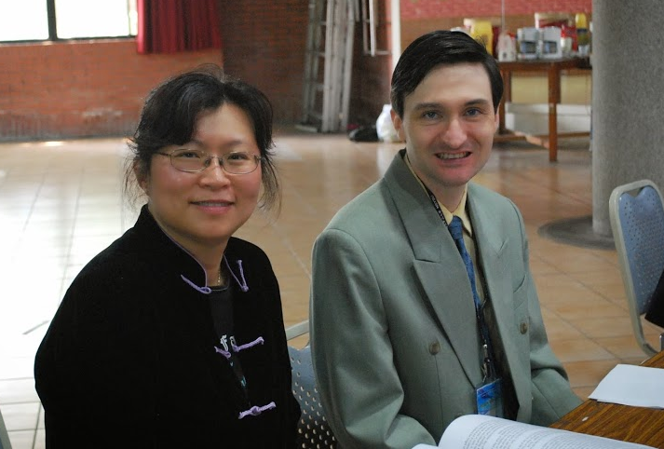
Several members were specifically encouraged by their fellowship with all of you, and also encouraged to understand the larger UBF ministry. Various members grew through the experience, and began campus fishing and serving the ministry in different ways

Slide 13
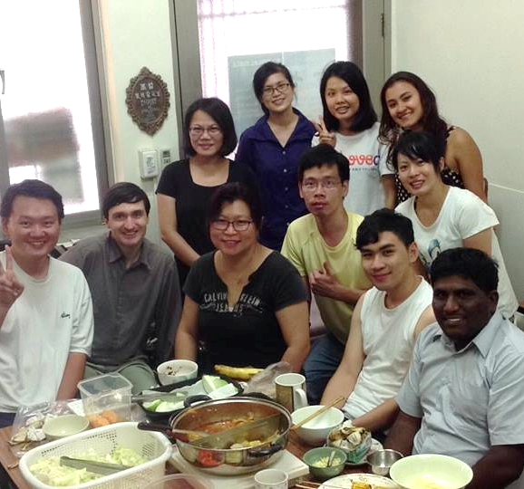
One key serving that members have shown is the voluntary spirit of many members to cook for the Thursday Group Bible Study and for the Sunday Worship Service. These works have contributed to the environment of fellowship.
Mid-moon festival
BBQ & Hot pot party

Slide 14
3. Special Programs
Immediately after the Director’s Conference, there were several programs, as some of you probably know, since many of you were there.

Slide 15
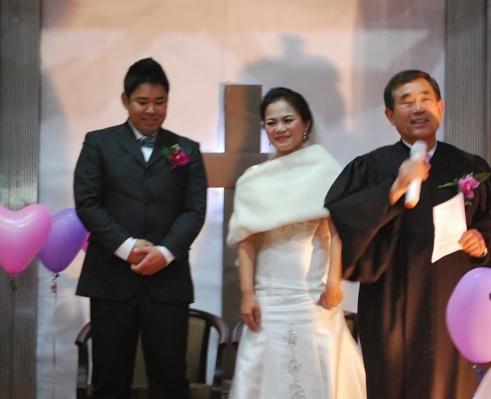
Mandy and Yoshi’s Wedding
Mandy and Yoshi’s wedding ceremony was an important way to outreach to this family. I was very encouraged that many UBF coworkers could bless their wedding. Mandy also was touched by it. Your support encouraged her.

Slide 16
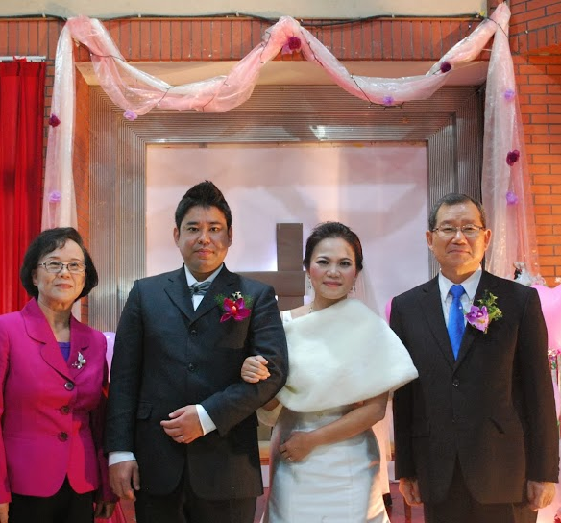
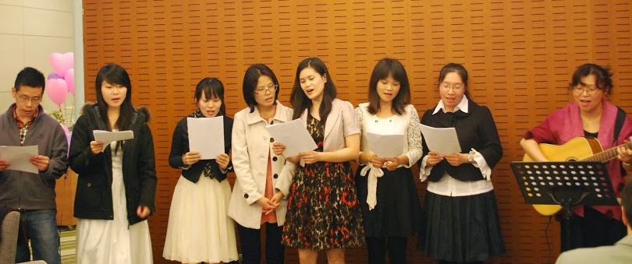
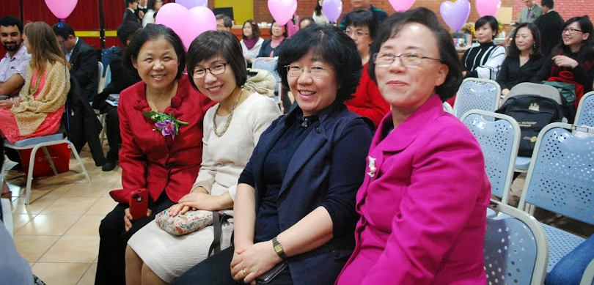
In the past year, it has been difficult for this family, because Yoshi has been job searching. Also she will deliver a baby soon. But UBF coworkers’ prayer and unconditional love encourages even Yoshi. Perhaps even these present difficulties might open the eyes of his heart.

Slide 17
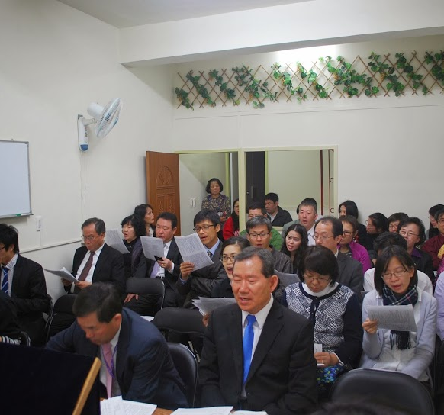
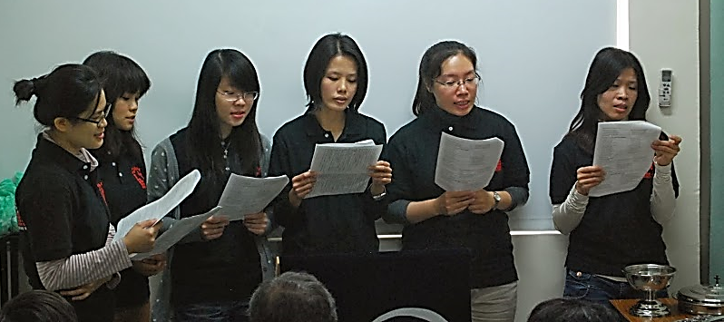
Next after the Director’s Conference, we had our center dedication ceremony. Many coworkers offered prayers and financial support for this center to be a house of prayer.
Bible Center & Dedication

Slide 18
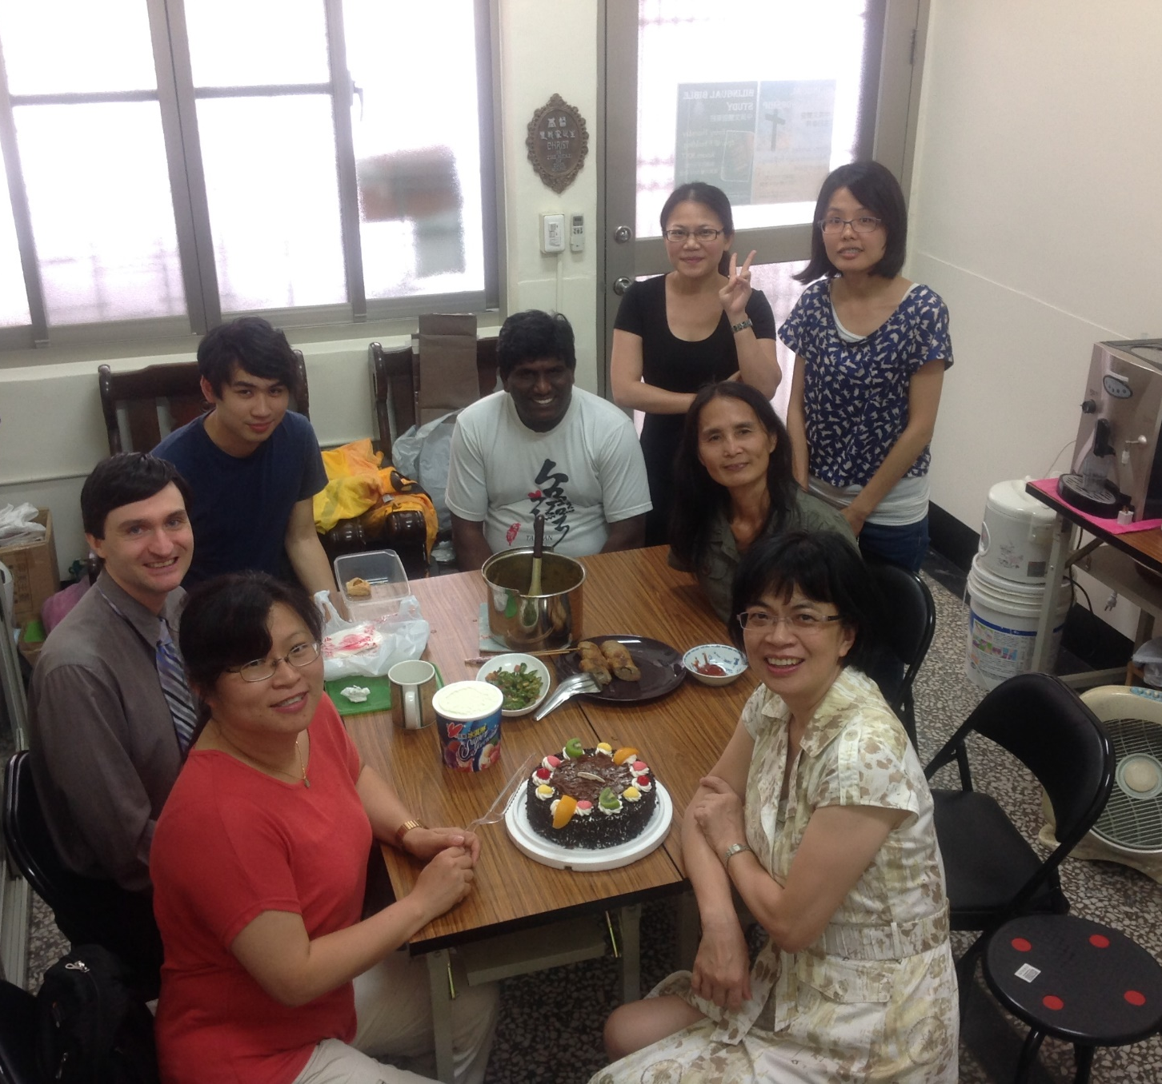
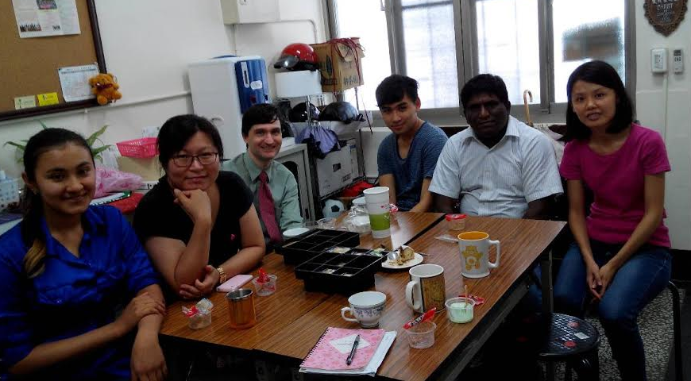
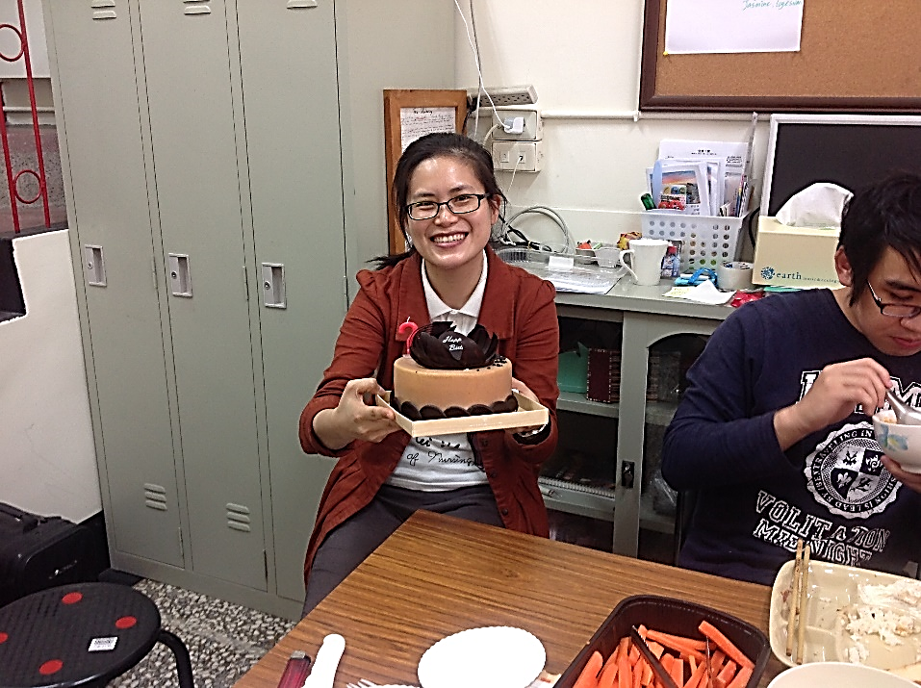
In the past year, the center has been an important place of fellowship. Some of our younger members come there to study or for eating fellowship. Currently, Nicki and Yawen have common life at the center (Naomi also did before going to America.)

Slide 19
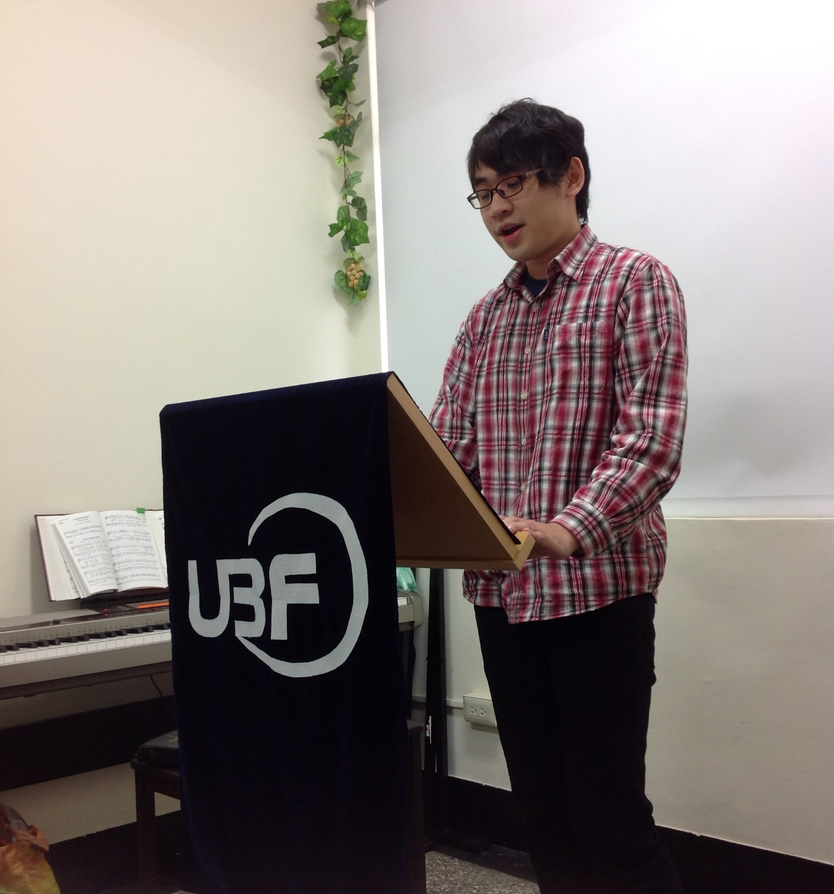
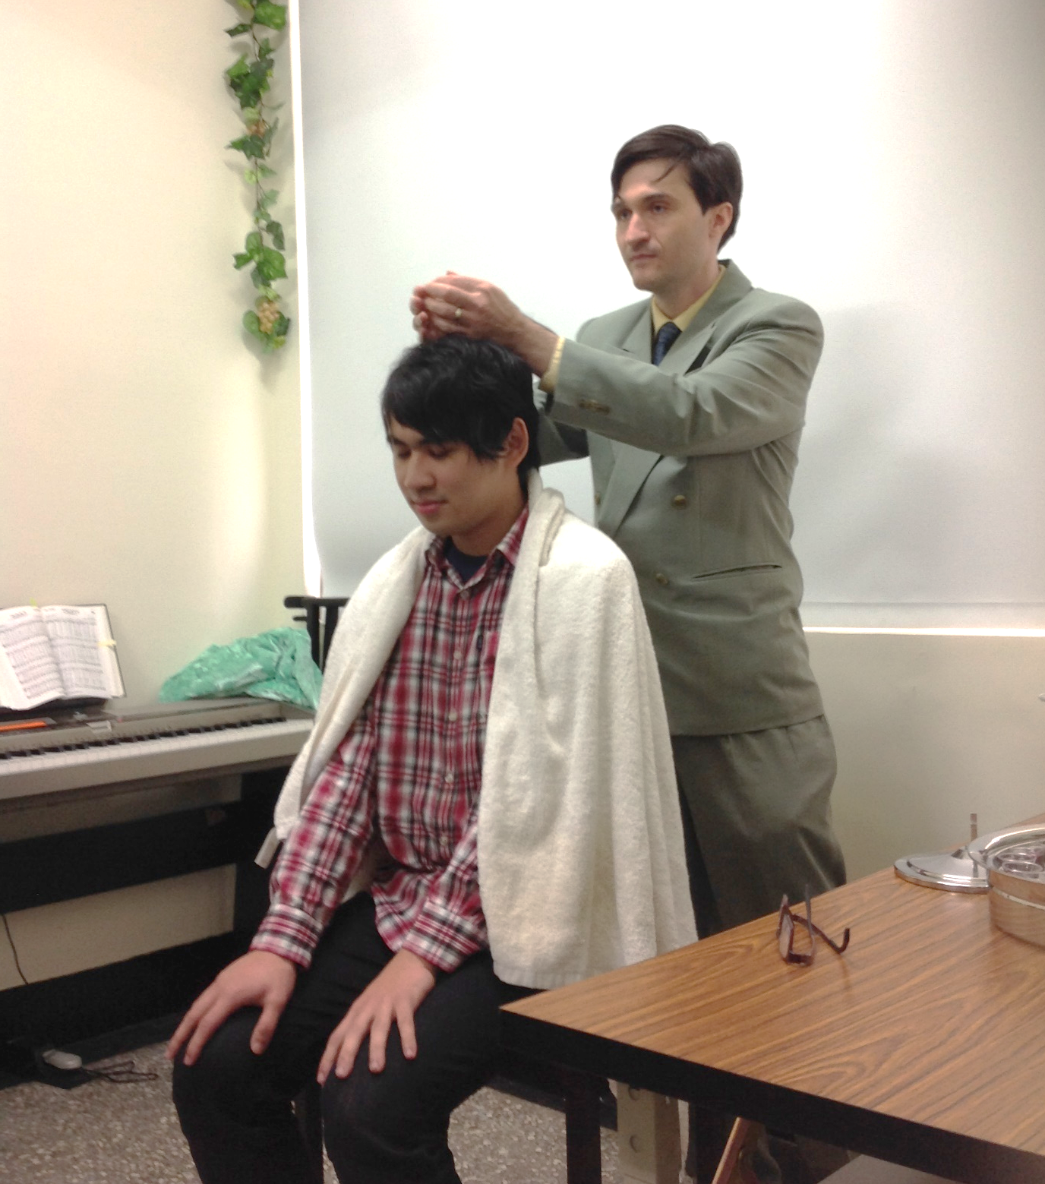
Also, during the center dedication, we had a baptism for Gregory.

Slide 20
He plays piano for our worship service and presides through passage reading. He has been inviting his friends. We are encouraged by him. (Our ministry has tended to be women graduate students. We had prayed for brother, for undergraduates, and for music majors to support our worship environment. Gregory is an answer to 3 prayers.) Gregory was fished in 2013 by Juan from Washington, during a short-term mission trip to our ministry.
Gregory will graduate this spring. He must do a year of military service. Then he will attend graduate school in Taipei and attend the Taipei ministry. We pray for him as an important firstfruits of our men ministry and for him to be well trained in his final semester to stand independently in faith during military service.

Slide 21
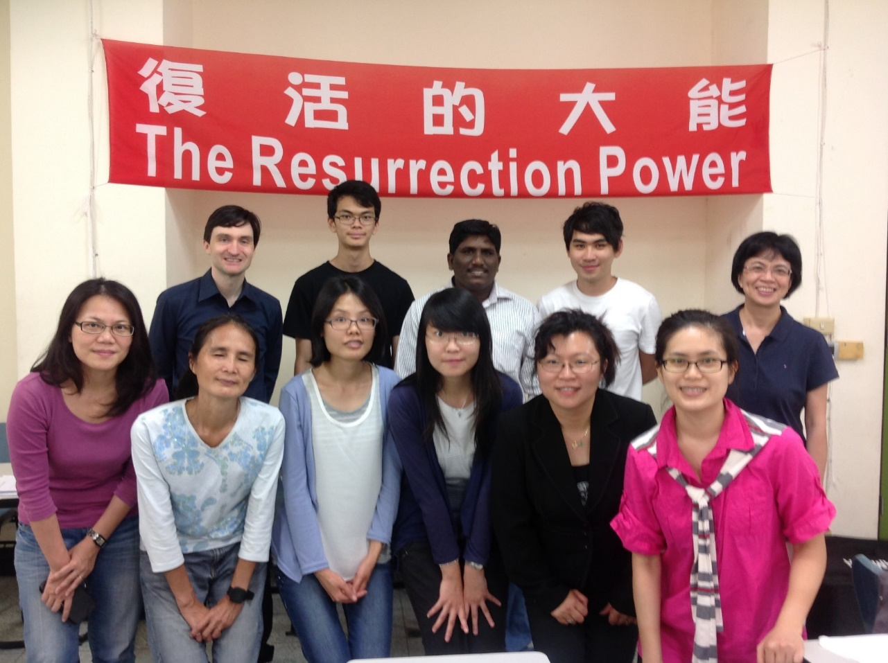
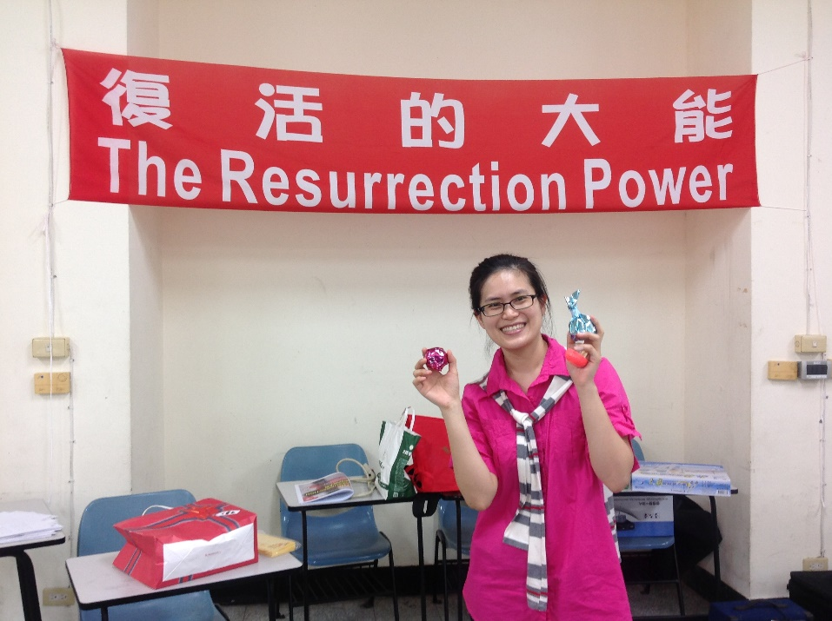
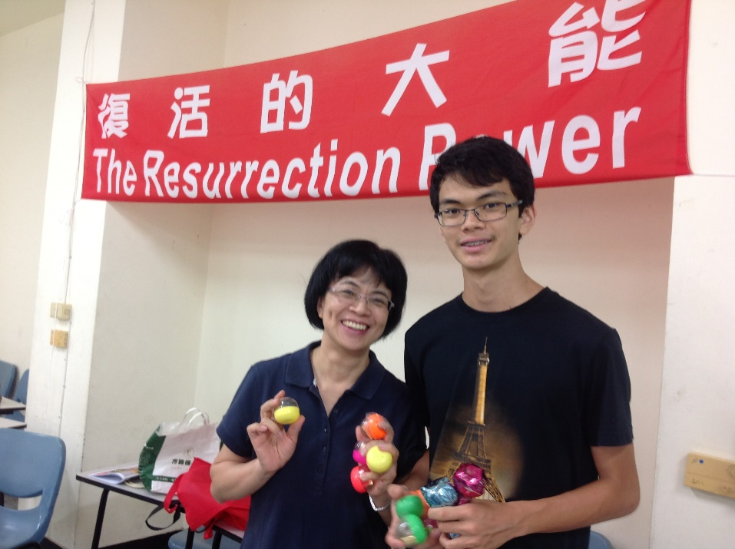
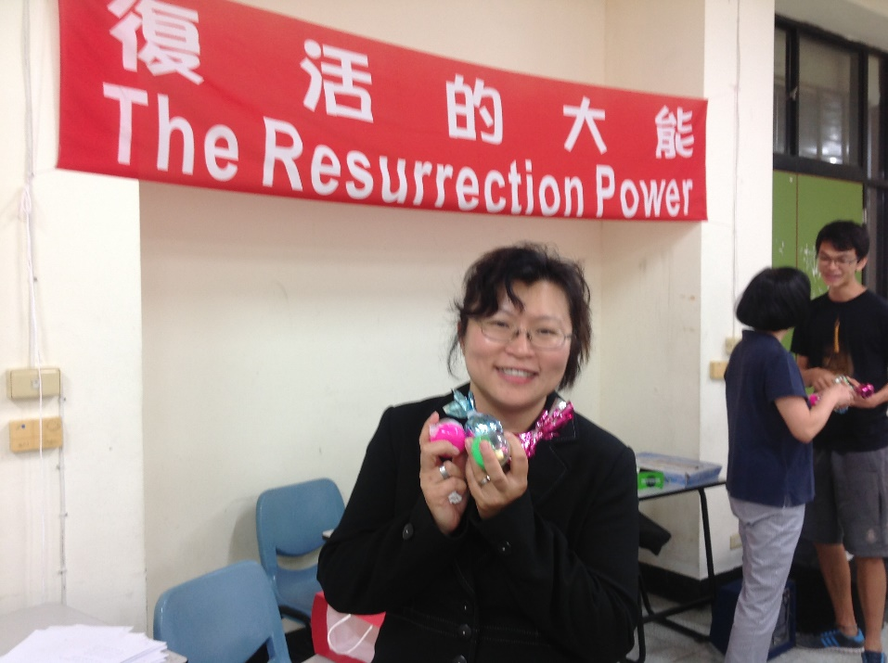
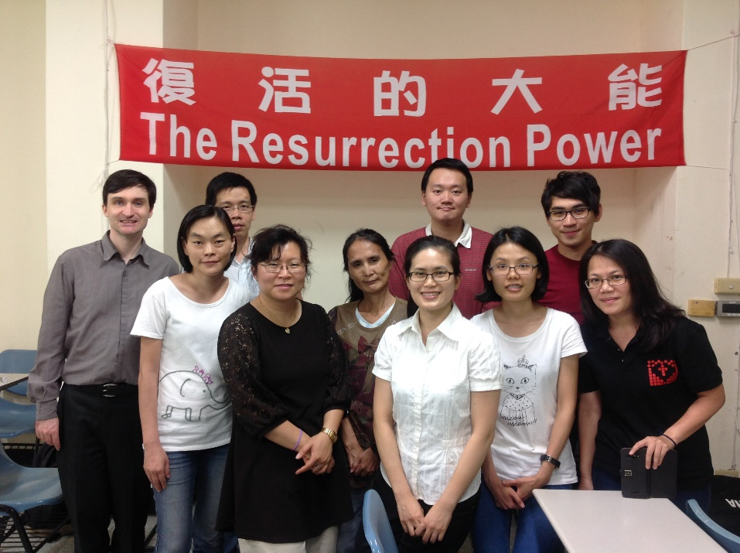
Our other special programs in the past year were:
1. The Easter Bible Conference. The program was encouraging, with a focus this year on the Resurrection Power. About 25 people attended either one part of the program or another.
Easter Conference

Slide 22
The Summer Bible Conference focused on Biblical persons who had transformational experiences through the grace of God. We were encouraged to be transformed by the renewing of our minds.
Gregory grew through the challenge to deliver a message on Jacob and the calling to struggle with God instead of men. It was his first message.
Also, Yawen’s message showed keen insight. In my proofreading, I had nothing to change in her message. It was as though I had written it.
Four co-workers from Hong Kong and two co-workers from Taipei attended our Summer Bible Conference. God also brought back many old sheep and friends coming from different cities of Taiwan to attend our summer conference as well.

Slide 23
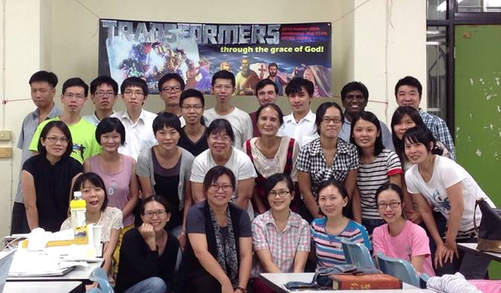
Summer Bible Conference

Slide 24
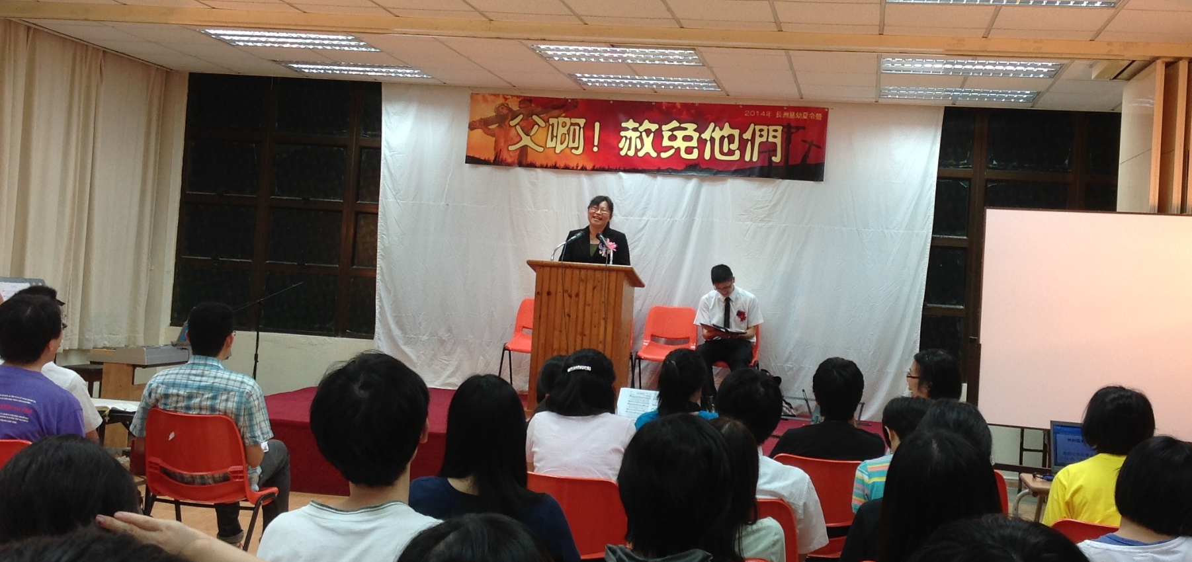
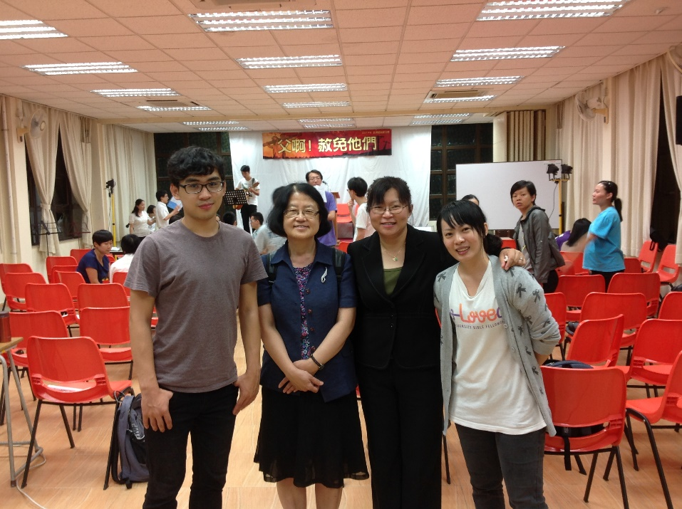
Also during the summer, several members attended the Hong Kong Summer Bible Conference, where Dr. Allison delivered a message on “you give them something to eat” It was an encouraging direction for her as she struggled with many busy works in teaching on campus.
Later, Shepherd Lam King Tin and Peggy from Hong Kong visited us in December, attending our Christmas worship.

Slide 25
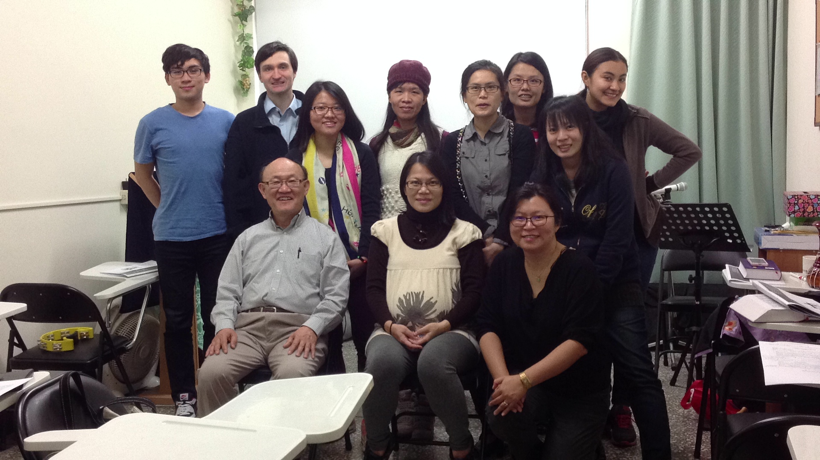
Romans New Year Conference
Just last week, Missionary Elijah visited from Washington and we had a short conference on the book of Romans. He prepared very diligently and many members had a learning mind to try to understand the doctrine of salvation by grace.

Slide 26
4. Answers to prayer
In the past year, God opened several doors. Allison got hired as a full-time professor in the Political Science Institute at our school. It is a contract position, and we pray for her research proposals and publication, which are necessary to allow for having a permanent tenure-track position. Yawen got admitted to PhD study in a new major and with scholarship. Gregory got admitted to study at an exclusive program in Taipei. Judy and Matthew received positions as research professors in Korea. Two international students attended our ministry. Stephanie, who is from Columbia, and Youwei, who is from Malaysia. Recently, Youwei returned to Malaysia.

Slide 27
5. Bible Study Ministry
This past year, we have continued the study of Luke’s Gospel. We also continued daily-bread publication work and Morning Prayer meeting. Around 10 people attend our Thursday group Bible study, and around 10 attend our worship service.
Our current Bible students are:
Steve: Gregory, Raju, KoBill, Matthew; Ravi, Michael & Joanne
Allison: Yawen, Mandy, Jenny, Chaixun, Zoe, Mina, Celine, Adan, Jimmy, Yoshinao, Judy
Yawen: Naomi, Jenny, Stephanie
Mandy: Tina
Tina: Yu-Yan
Celine: Patty
GBS only: Yanting, Yanling
SWS only: Iris

Slide 28
Part 2.
2015 Key Verse:
“Therefore go and make disciples of all nations, baptizing them in the name of the Father and of the Son and of the Holy Spirit, and teaching them to obey everything I have commanded you. And surely I am with you always to the very end of the age.” (Matthew 28:19-20)

Slide 29
Jesus was about to leave to heaven. But he assured his disciples that he would, in fact, be with them always. He sent them into all the world to preach the good news to all creation. But he would be with them wherever they were, whenever they were, to the very end of the age.
These words were not just for those disciples, they stand until the end of the age. Since the age still persists, so does this command and this promise.

Slide 30
In the new year, we pray for our members to remember that Jesus is with them always. Some have gone out and so that they may fellowship with Christ even at the ends of the earth. Others will go out this year: Nicki and Raju will graduate and need to find a postdoc. Gregory will graduate and need to do mandatory military service. Others may stay, but have difficulties and need to remember that Jesus is with them always. We pray also for younger key members, such as Gregory to be raised up as disciples. We must remember the call to disciple making.

Slide 31
SPECIAL PRAYER TOPICS
1. 20 one-to-one each week and 20 faithful SWS attendants
2. Steve’s Sunday Message & Allison’s translation
3. Thursday and Friday GBS
4. Mandy’s safe delivery
5. Zoe’s baptism
6. Steve’s continuous stay in NSYSU
7. Allison’s NSC book writing proposal can be accepted and SSCI journal publications
8. Nicky’s Ph.D. defense and graduation
9. Yawen’s Ph.D. study
10. Taipei ministry: Jenny to co-work well with Mark and Gloria
11. Tina, and others, to have a marriage candidate
12. Naomi’s return to Kaohsiung and graduation

Slide 32
Also, a few words about Taipei UBF
Because that report is not in the program booklet
First, an update: You may remember that, at last year’s director conference, Dr. Mark shared bout his need to find a new position by last summer
  Unfortunately, he did not find
  Fortunately, his boss extended his work
    Please pray for his job search. Especially to find a position in Taipei.

Slide 33
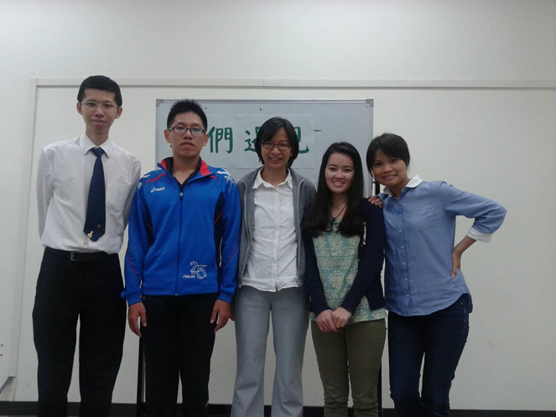
Sunday worship service in 2014
Studied Genesis and Romans this year, and have 4 stable Sunday Worship attendants.
One sheep Brother Li graduates with a master’s degree and move to work in Shanghai, China. He attends our Sunday service faithfully by using Skype.
A Mongolian shepherdess Sarnei studies in the central part of Taiwan and attends our Sunday service once a month.

Slide 34
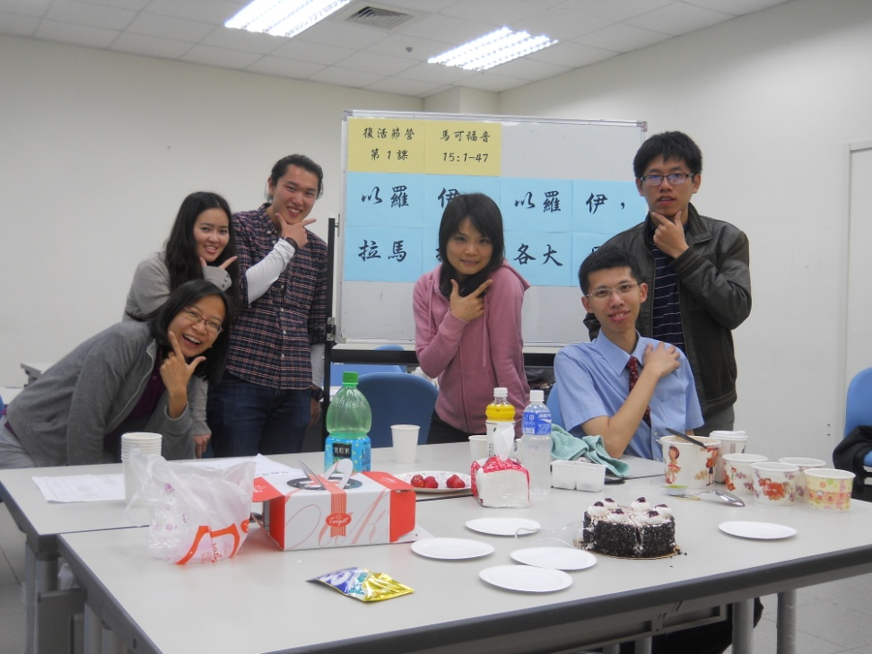
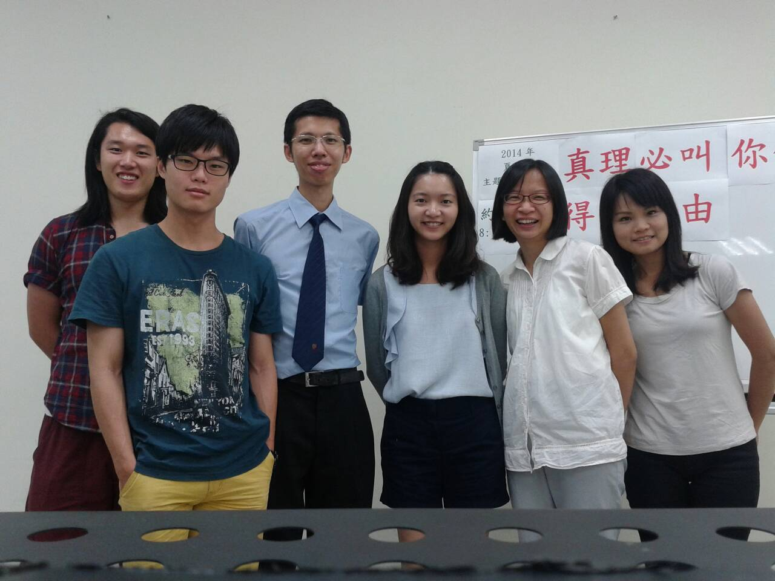
Bible Conferences in 2014
New Year Bible conference (25/1-26/1)
Easter Conference Summer Conference

Slide 35
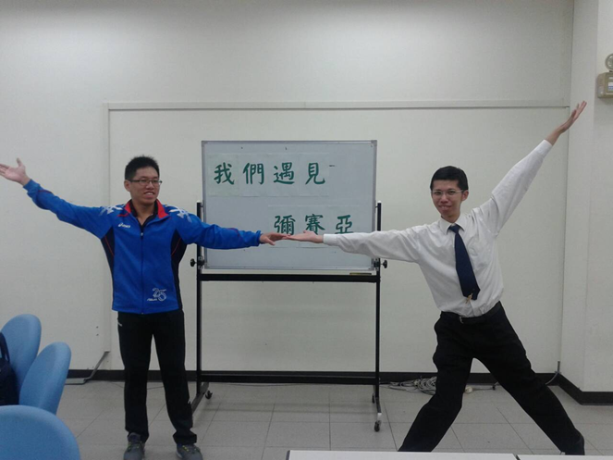
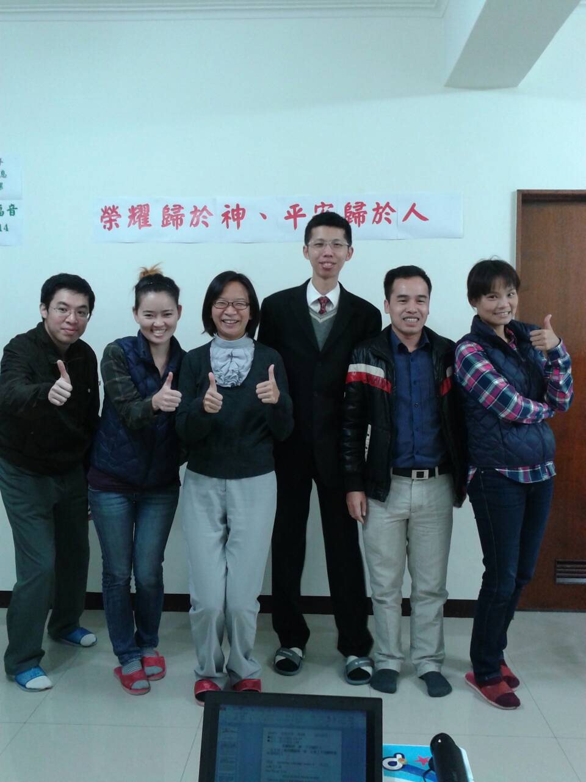
Autumn bible conference (10/18-19)
“We have found the Messiah.”
Christmas Sunday Service

Slide 36
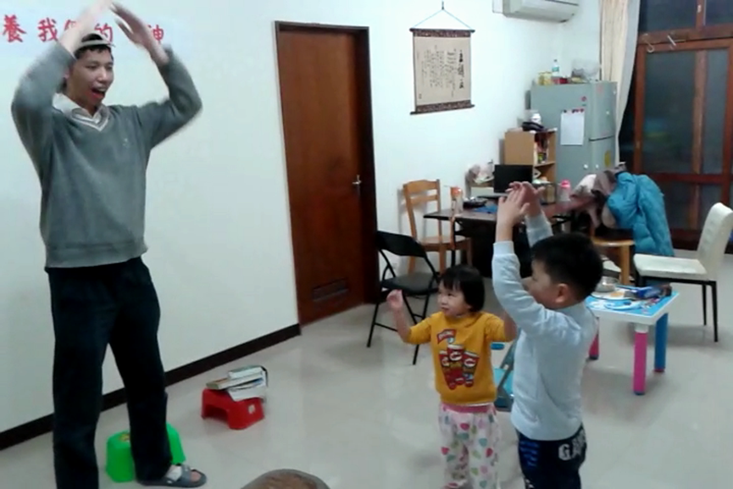
Baby Bible Fellowship
Paul (5-year-old) and Grace (3-year-old) attends our compulsory Sunday service.
25-minute Sing-spiration.
5-minute Sunday message.
1-minute prayer.
Evening Sunday service

Slide 37
Vision and Prayer topics in 2015
New Year Key Verse:
“Fixing our eyes on Jesus, the pioneer and perfecter of faith. For the joy set before him he endured the cross, scorning its shame, and sat down at the right hand of the throne of God.”
(Hebrews 12:2)

Slide 38
Prayer Topics for Taipei ministry
Missionary Mark Hui's powerful Sunday message with 5000 Chinese characters.
To raise Missionary Mark as a professor shepherd.
To establish Abraham of Faith and Sarah.
To raise up 12 Sunday worshippers.
To have 16 one-to-one bible studies.

