Slide 1
Introduction of Austria UBF
29.05.2015
Chicago, USA

Slide 2
Pioniering key word of God
“This, then, is how you should pray:
“ ‘Our Father in heaven, hallowed be your name, your kingdom come, your will be done, on earth as it is in heaven.
(Matt 6:9.10)

Slide 3
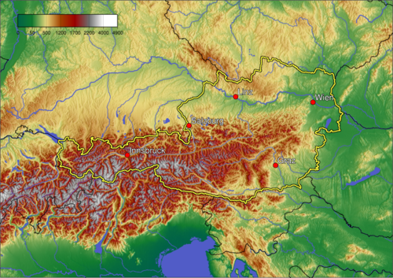
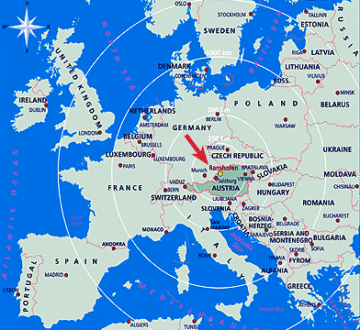
Which land is Austria?
Capital: Vienna
Language: German
Goverment: Federal parlamentary Republic
Area: 83.871 km2, 62% Aplen
Ethnic group:
81.1% Austrians
2.7% Germans
2.2% Turks
14% other / unspecified
Neighbor countries: borded by: 8 countries
Czech Republic and Germany
to the north
Hungary and Slovakia
to the east
Slovenia and Italy
to the south
Switzerland and Liechtenstein
to the west
Uni. campus: 26 (national and private),
284.455 students

Slide 4
Spiritual Aspect
Religion distribution:
63.5% Roman Catholic
7.0% Muslim
6.0% Orthodox Churches (mostly Serbs)
3.7% Protestants
19.7% no religion by 2015
Austrian thinking of God(Eurobarometer Poll 2010)
44% of Austrian citizens responded that "they believe there is a God".
38% answered that "they believe there is some sort of spirit or life force".
12% answered that "they do not believe there is any sort of spirit, God, or life force".

Slide 5
The grape tree of history

Slide 6
God´s Work in Austria
Feb. 1995 | M. James and Sarah Han started as German Missionary in Aachen, Germany
Nov. 1995 | Lydia Han born as the first daughter
June 1996 | M. James family came back to Korea
Jan. 1997 | M. James Han arrived in Graz with M. Sarah Han and Lydia Han as Austrian Missionary
Oct. 1997 | M. James Han begun his life as PhD student missionary
Jan. 1998 | Little Sarah Han born as the second daughter
Sept. 1999 | Lois Han born as the third daughter
Mar. 2003 | M. James han finished his PhD work
Dec. 2003 | Shepherd Epaphroditus(Sung-Hoon) Kim (16 years old.) joined in Austrian ministry as high school student
Sept. 2004 | M. Daniel Yang family joined in Austrian ministry.

Slide 7
God´s Work in Austria (continued)
July 2004 | David Han born
May 2005 | Family M. James Han obtained the Austrian citizenship
Jan. 2005 | Austria ministry moved from Graz to Vienna
Oct. 2008 | Paula Han born as the 4th daughter
March 2011- | M. James Han got a research job in AIT Austrian Institute of Technology
Sept. 2013 | M. Daniel got a job as a diplomatic driver in the Korean Embassy in Austria
Oct. 2013- | House church changed to center ministry near University of Vienna

Slide 8
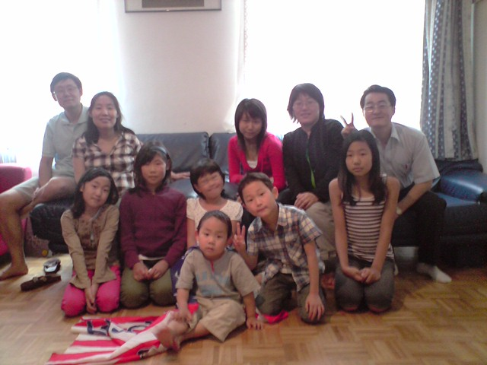
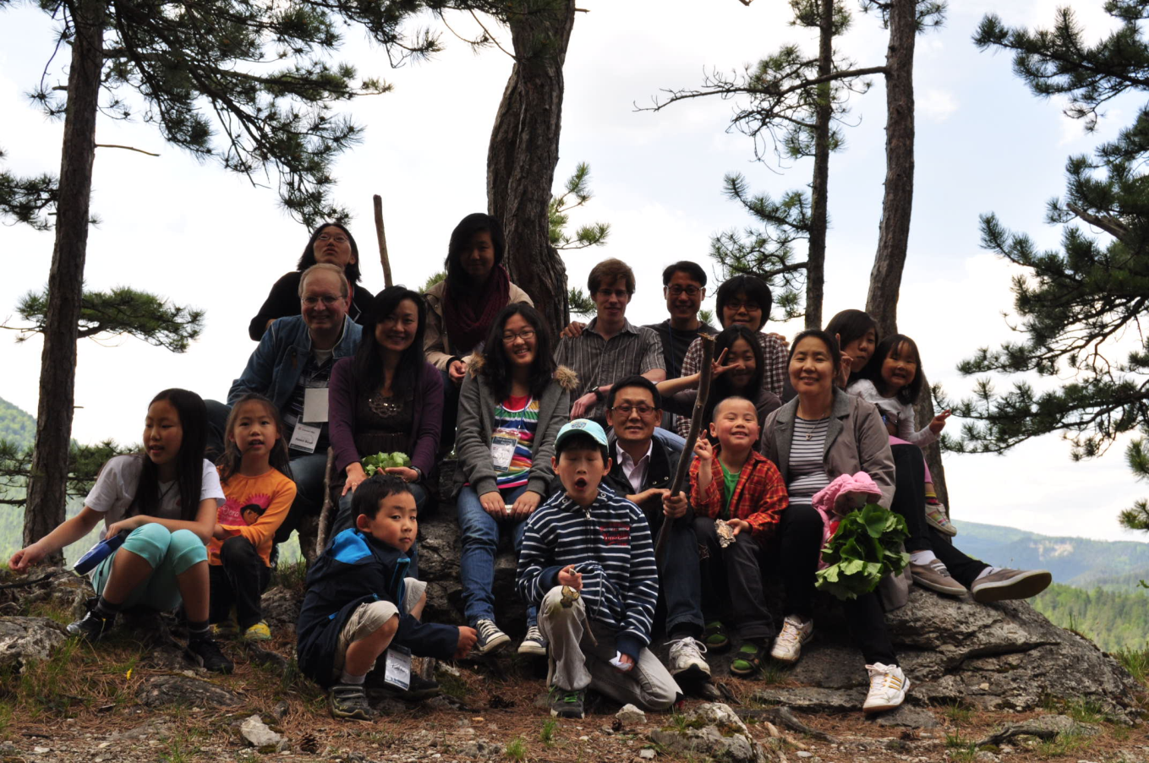
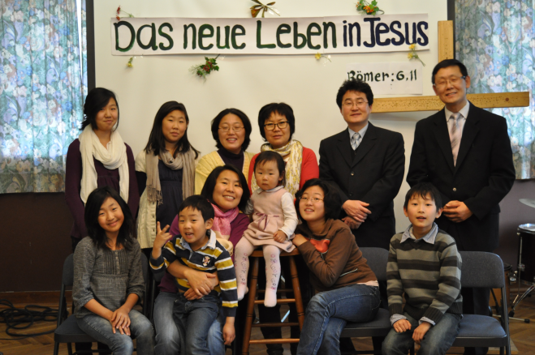
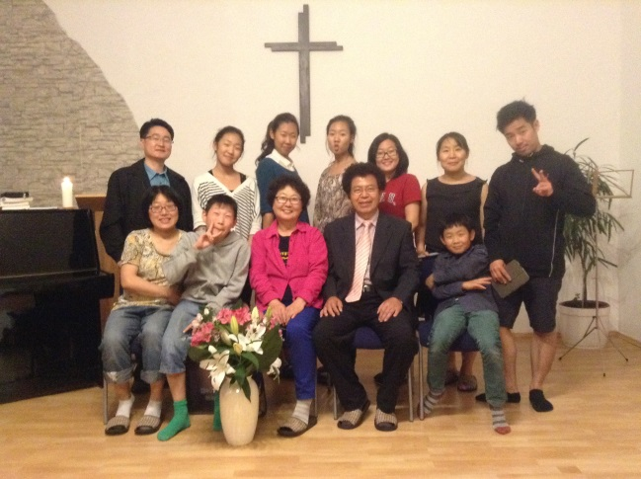
Change of Austia UBF

Slide 9
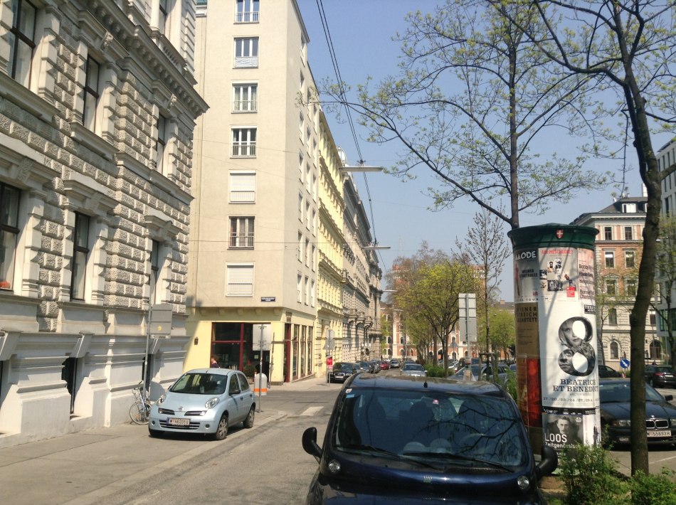
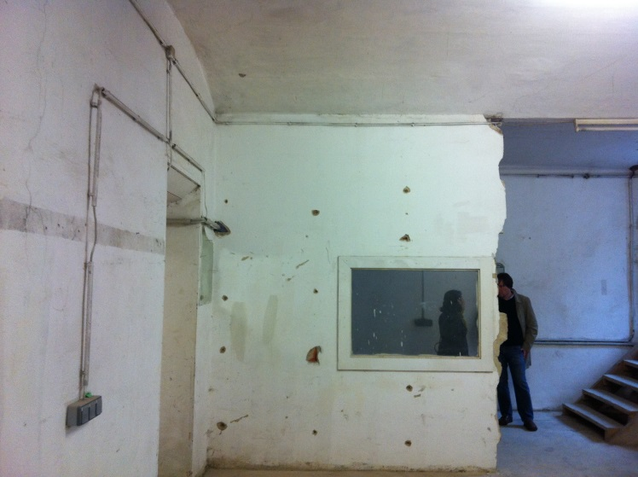
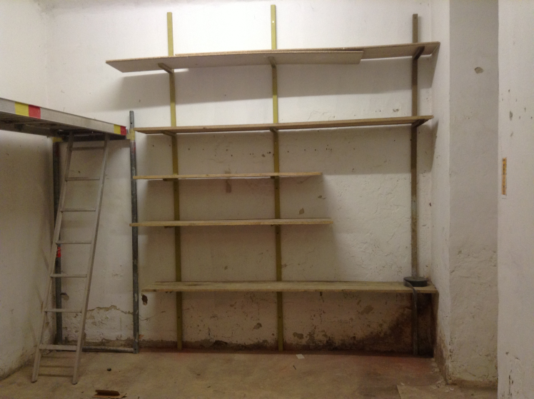
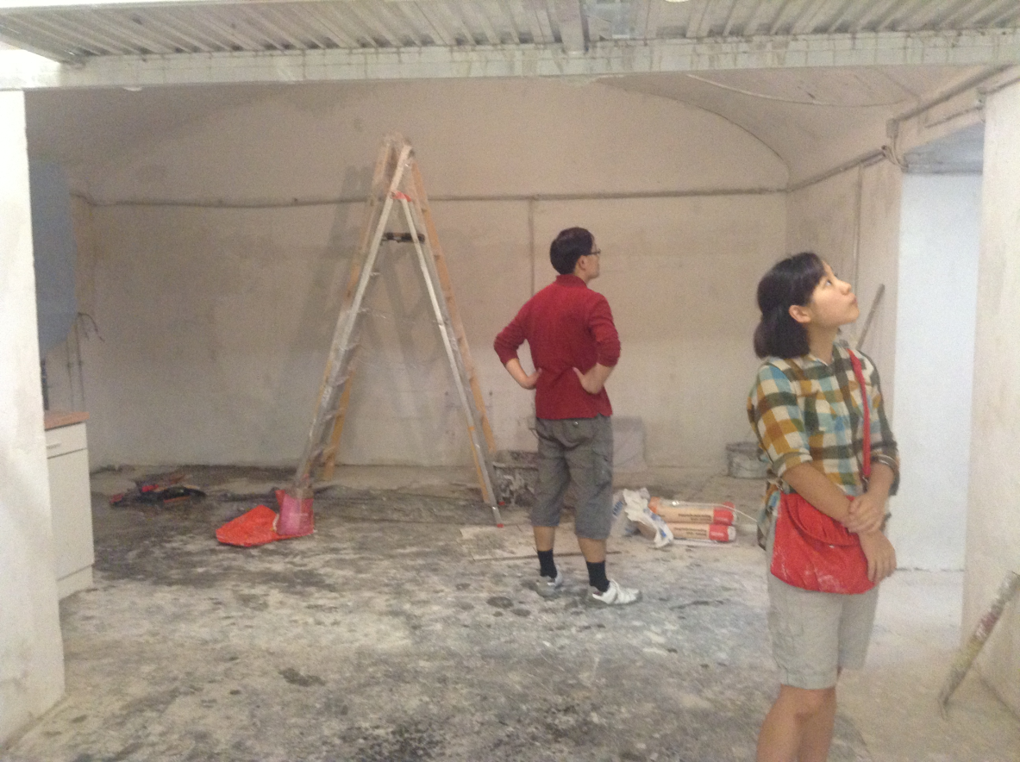
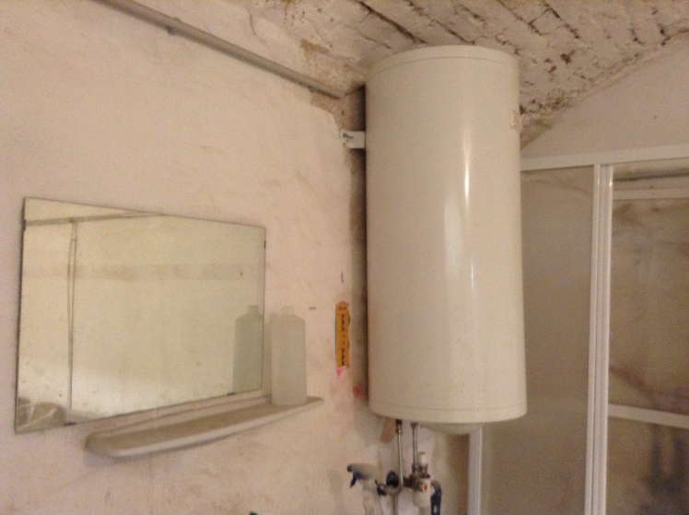
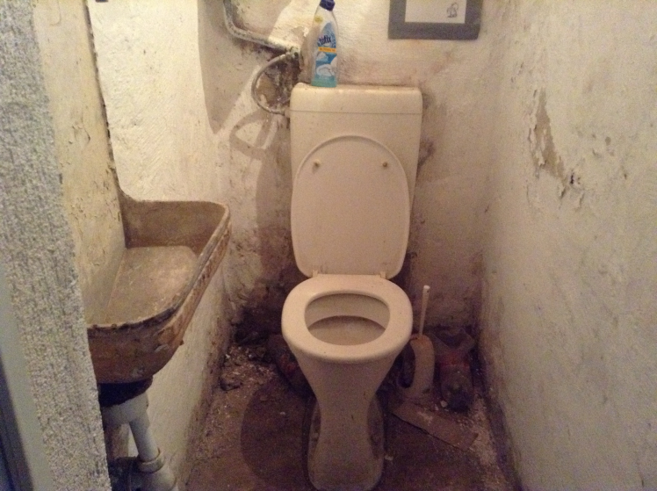
New bible house

Slide 10
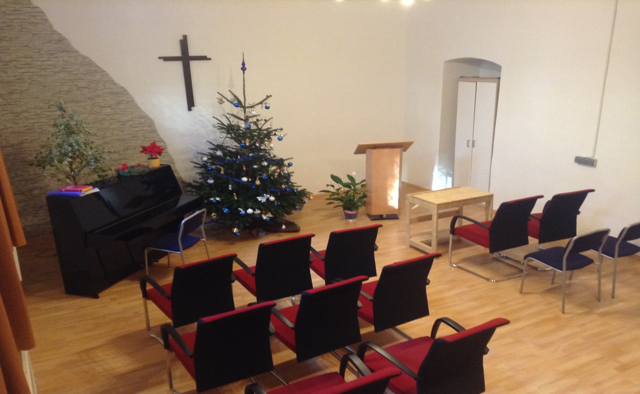
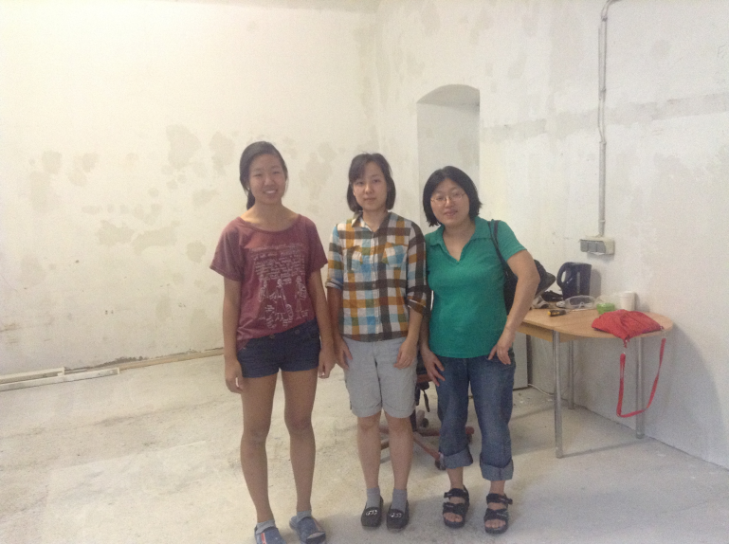
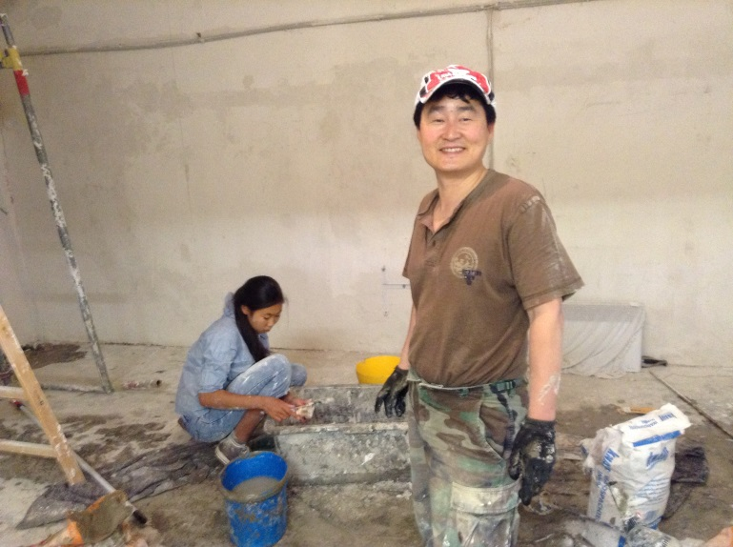
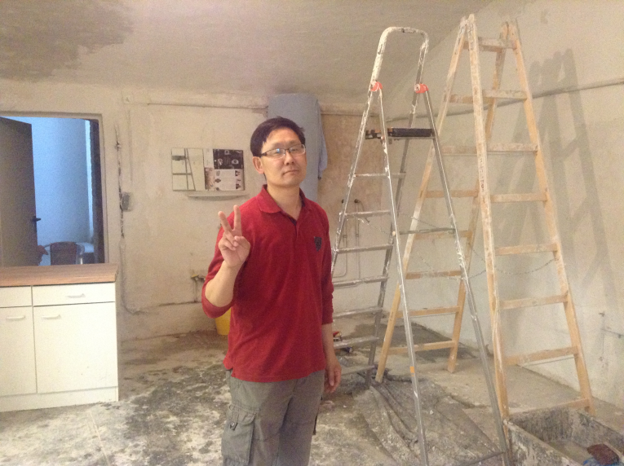
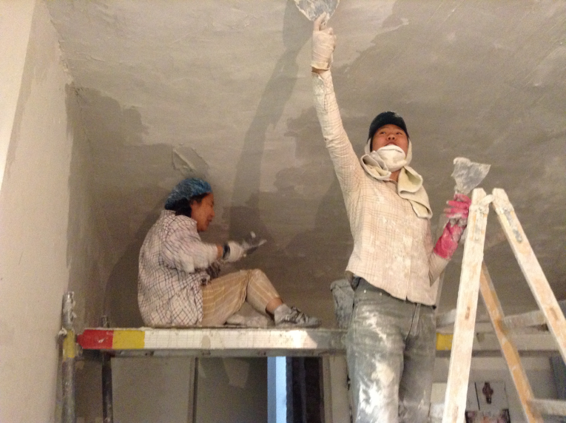
Challenge and God´s glory

Slide 11
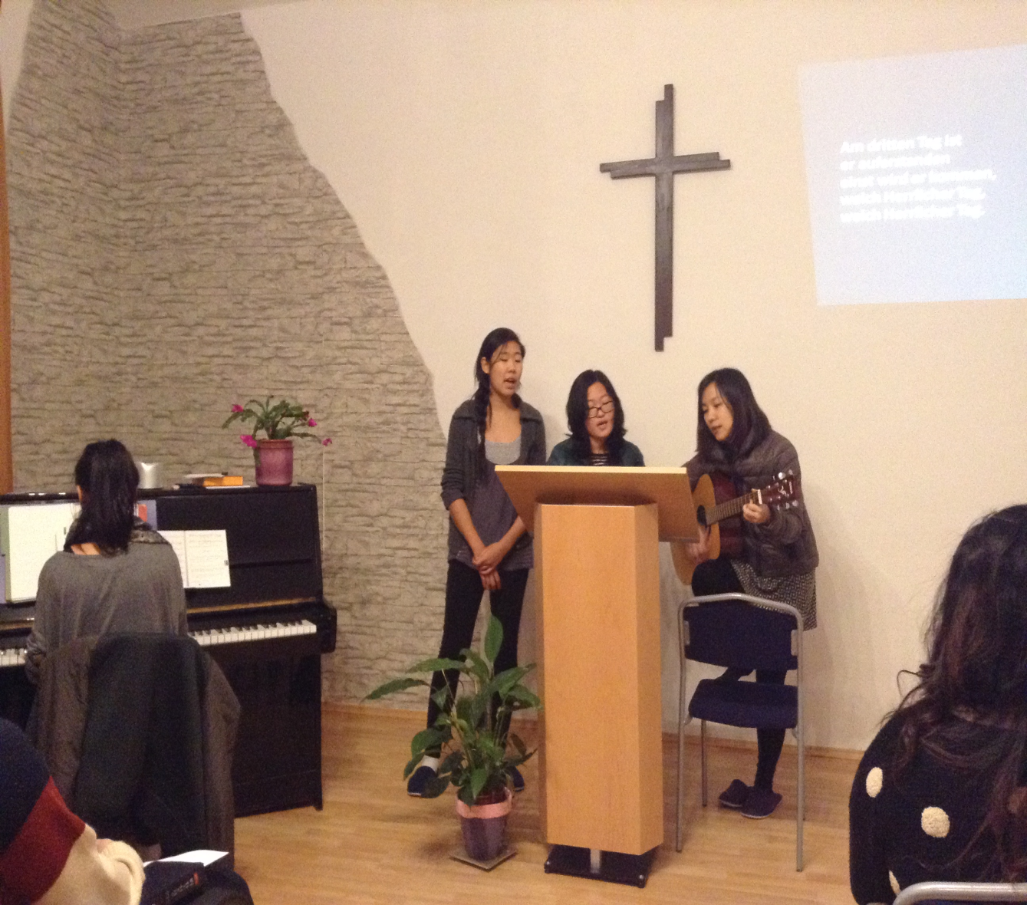
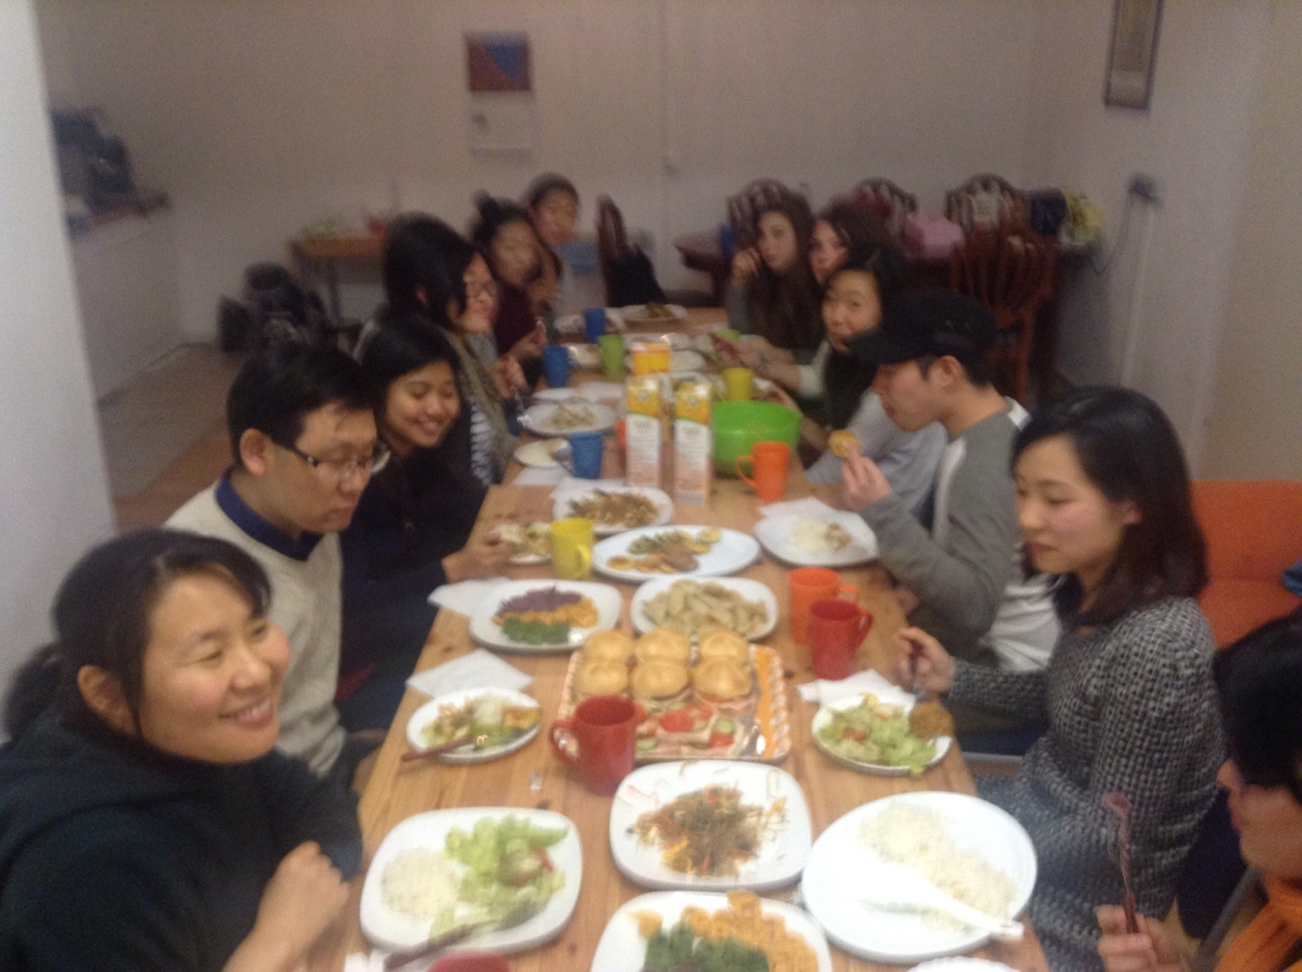
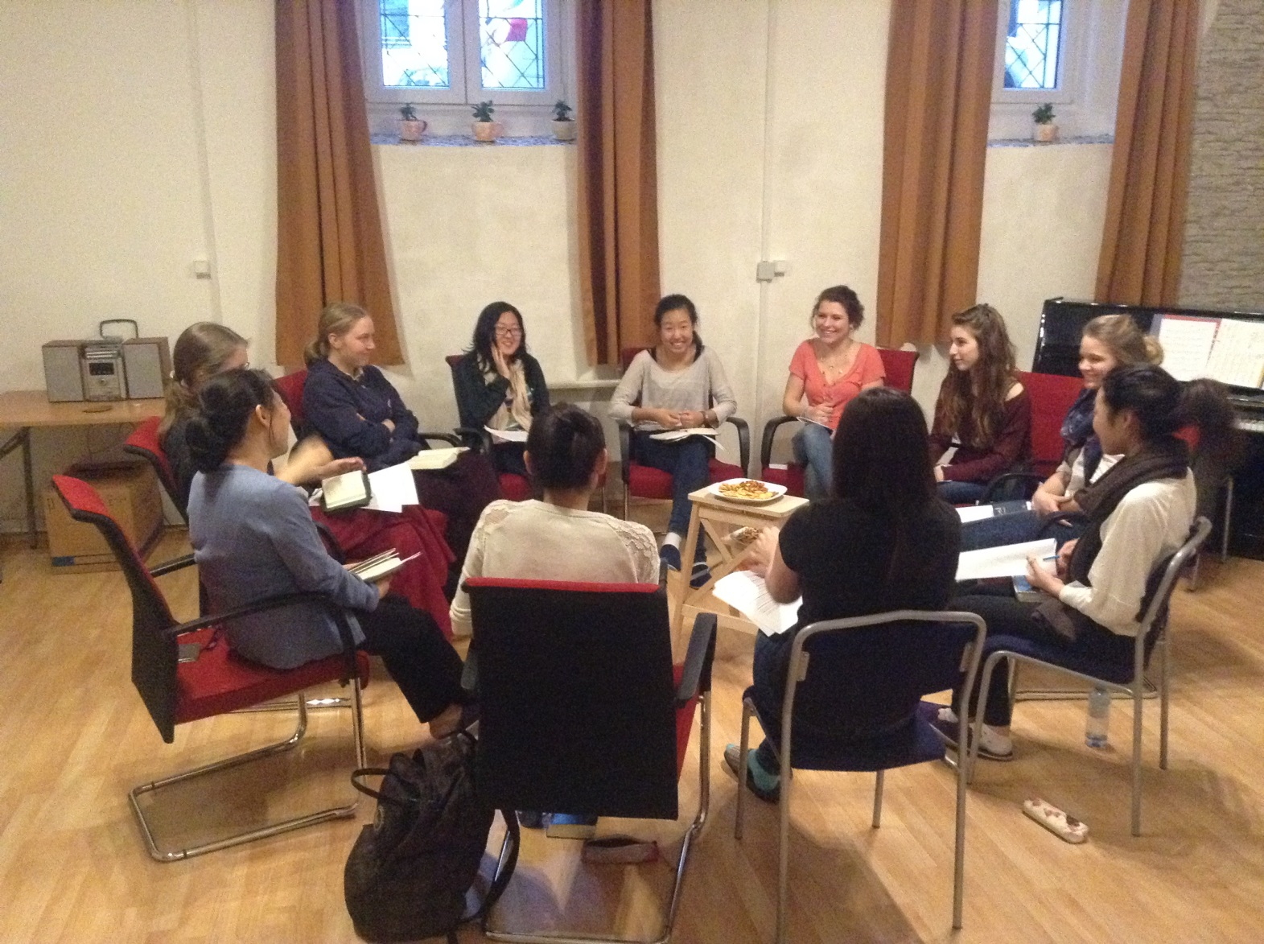
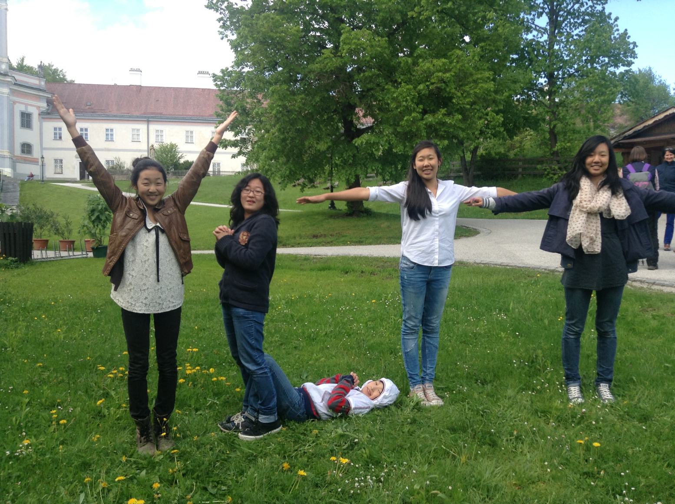
Spiritual activities

Slide 12
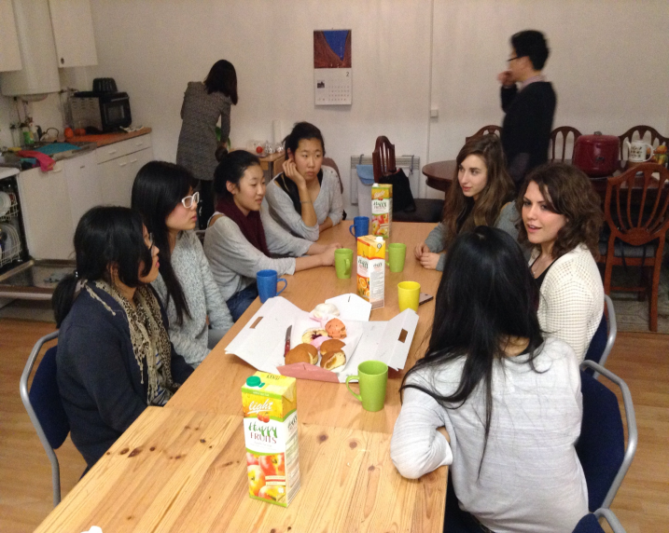
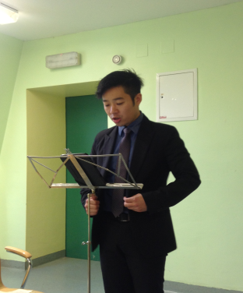
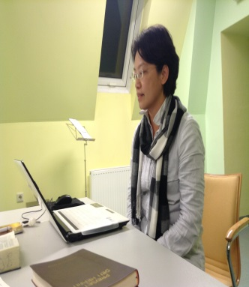
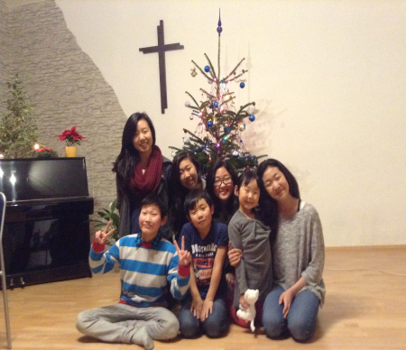
Prayer Topics of Austria UBF
Jesaja 43:19 „See, I am doing a new thing! Now it springs up; do you not perceive it? I am making a way in the wilderness and streams in the wasteland
Jesaja bible study and next book
To raise 1 Abraham and 1 Sarah
Austria to be a priesthood nation in Europe
To raise the 2nd children as a spiritual bible teacher through YLTT
Shepherd Epaphroditus Kim(Master course), Lydia Han(entrance examination in Vienna medical university), Saolin Zhang (law PhD study)
Monthly bible school (last Friday, John gospel, SWS message of Epaphroditus Kim)
Weekly bible night
Spiritual rebirth: Anita Moso, Naomi, Lea, Saolin

