Slide 1
Central America Visit Report
Pastor Abraham Kim
April 23, 2015

Slide 2
Honduras - Baptism
Mexico Conference

Slide 3
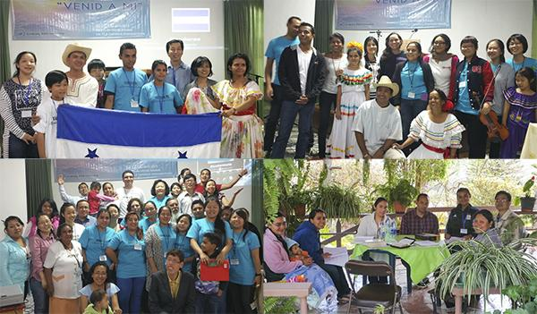
Central America Conference

Slide 4
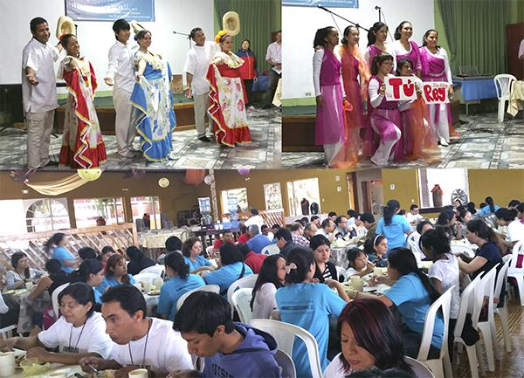
Central America Conference

Slide 5
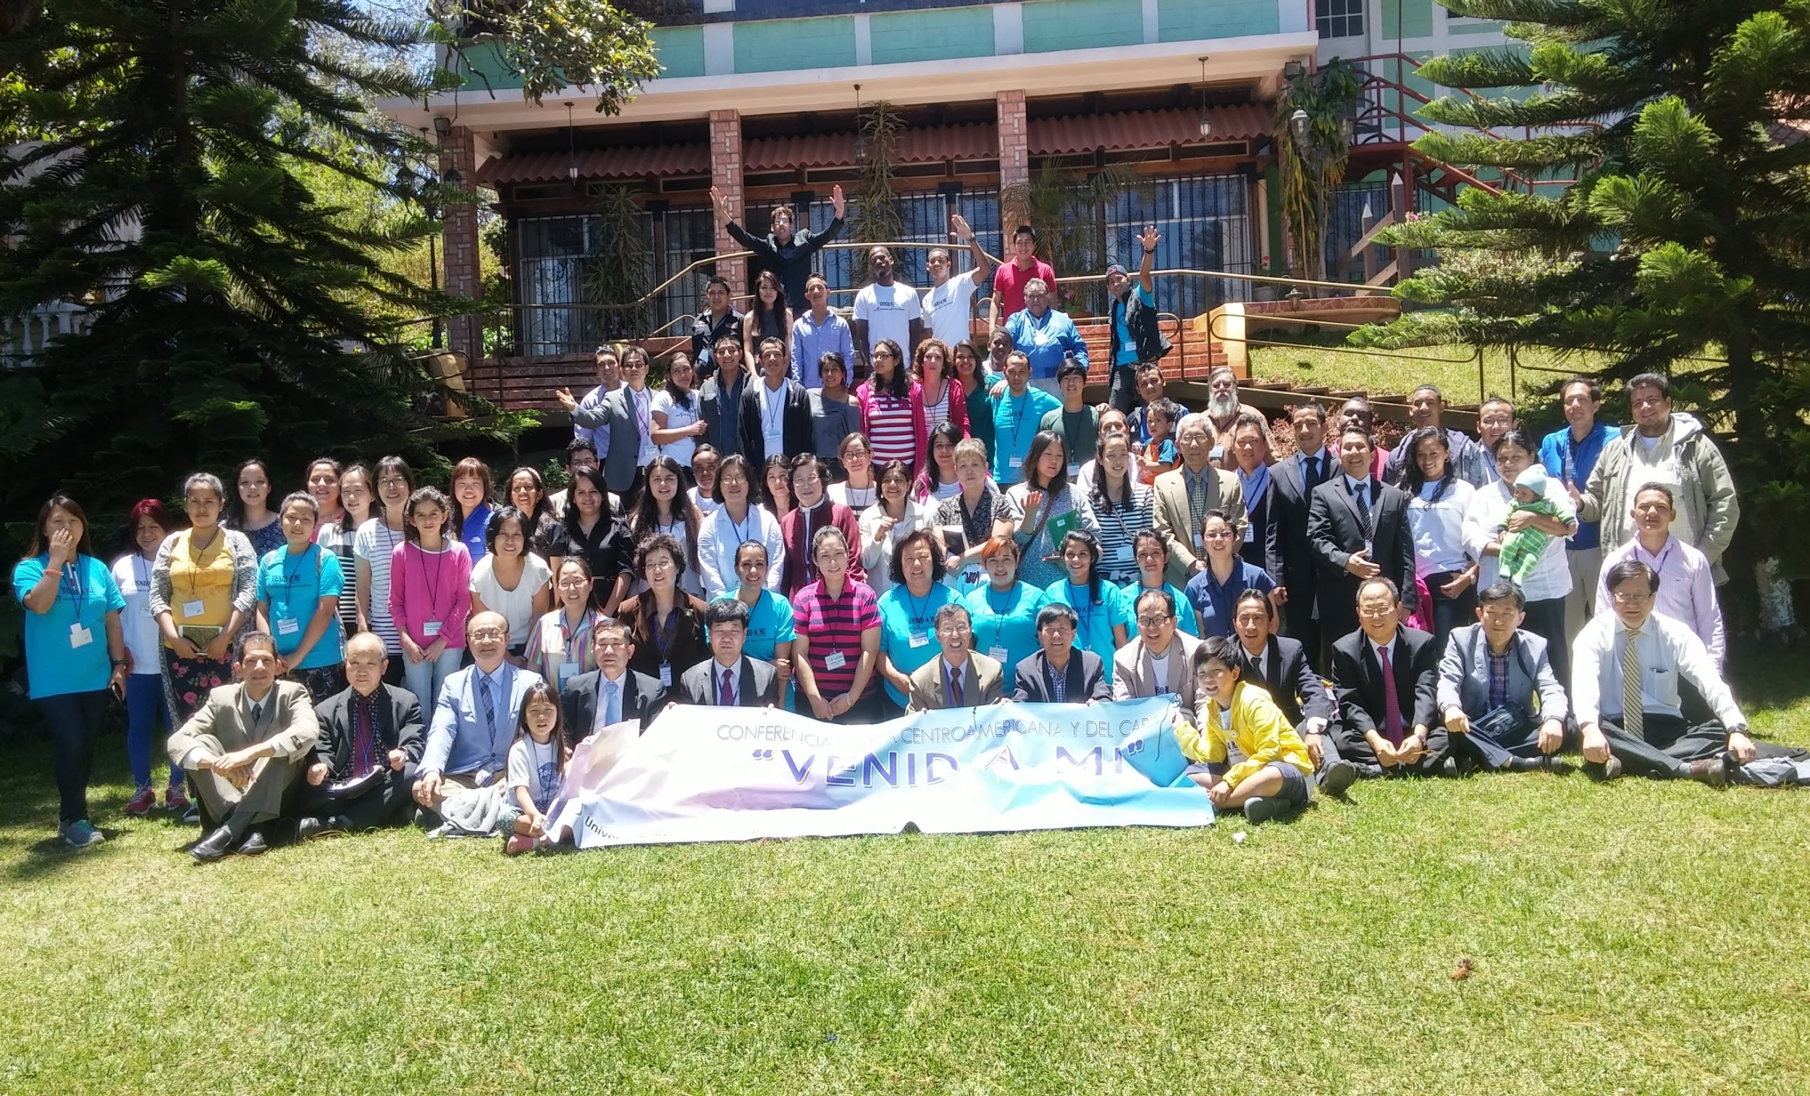
Honduras - Baptism

Slide 6
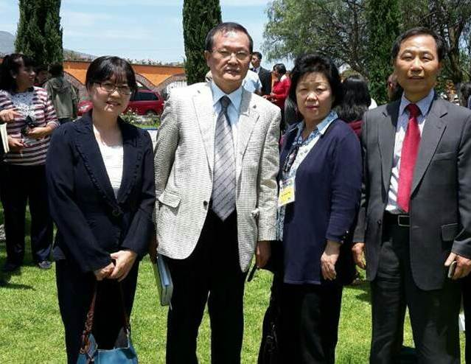
New York Delegates

Slide 7
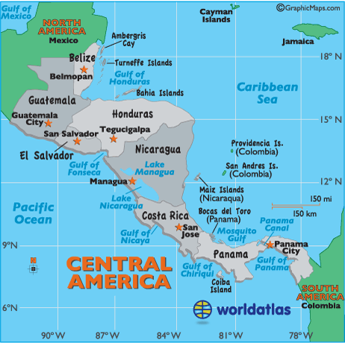

Slide 8
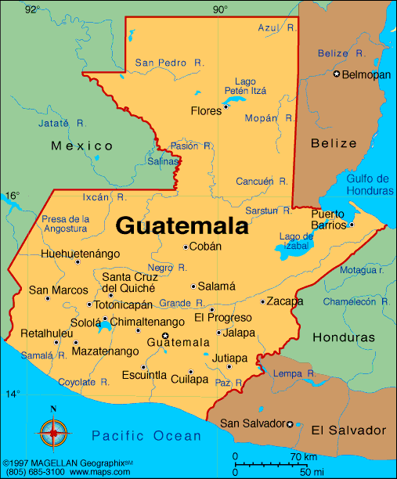

Slide 9
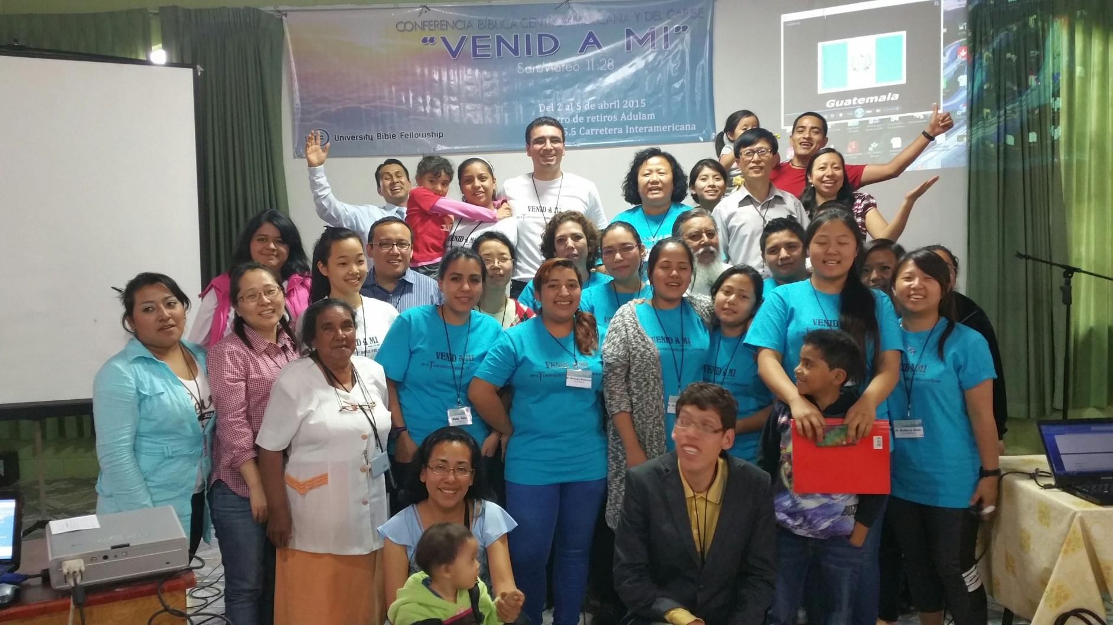
Honduras - Baptism
Honduras

Slide 10
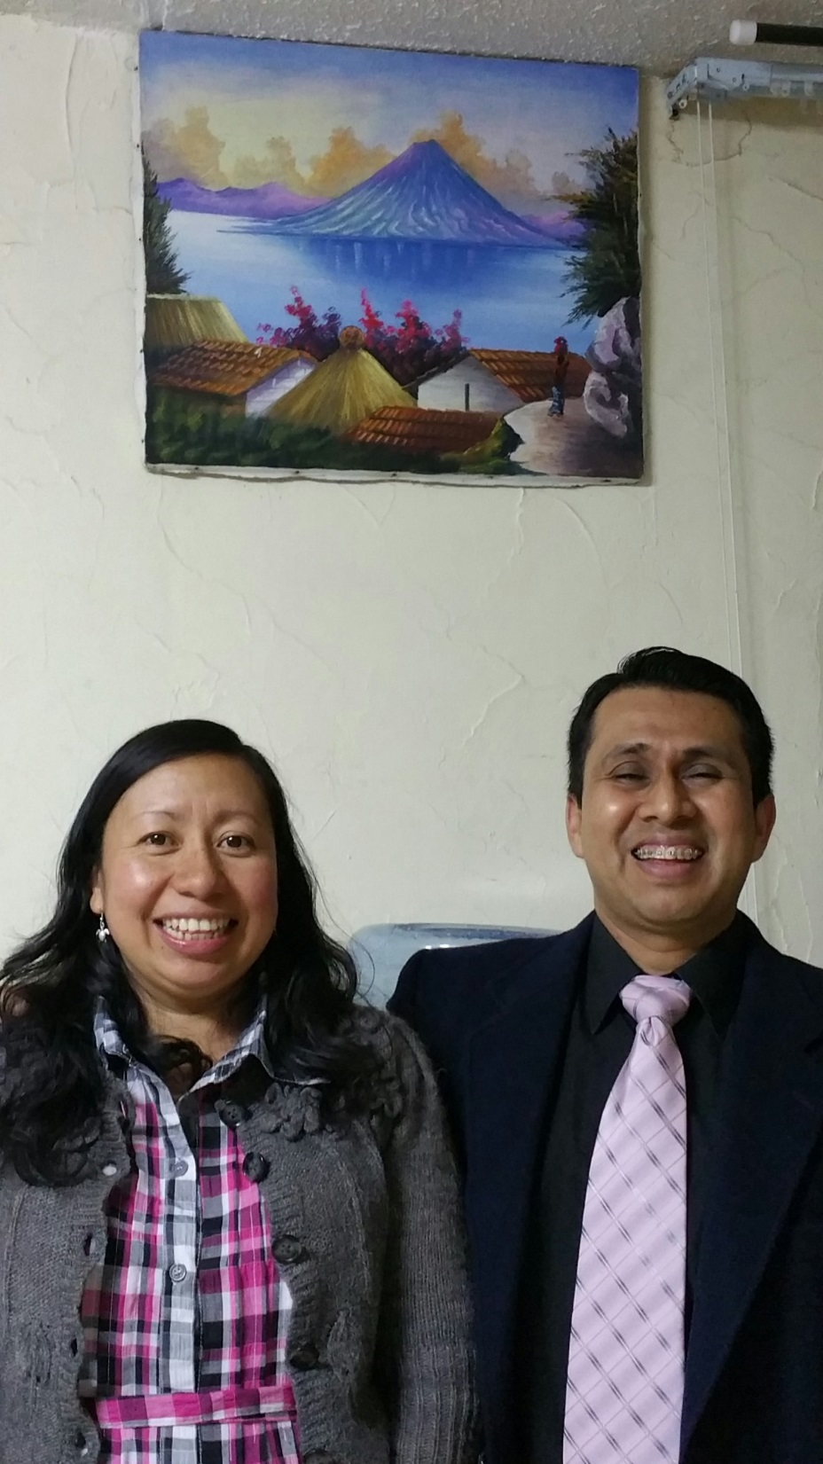

Slide 11
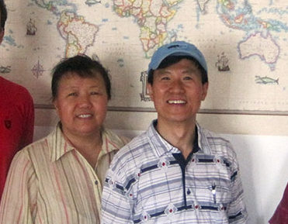

Slide 13
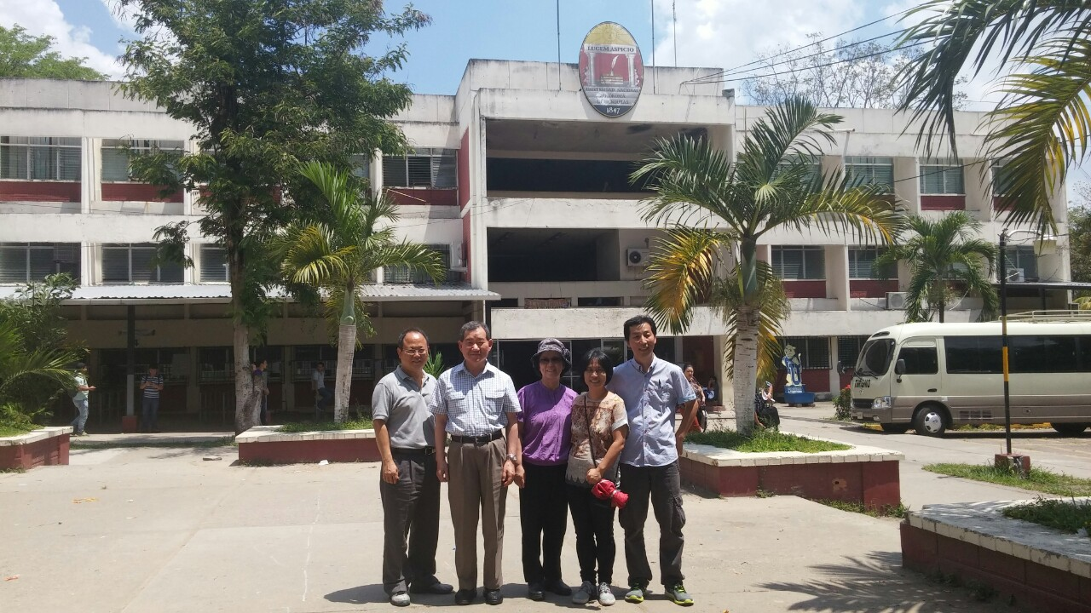
Honduras
Honduras - Baptism

Slide 15
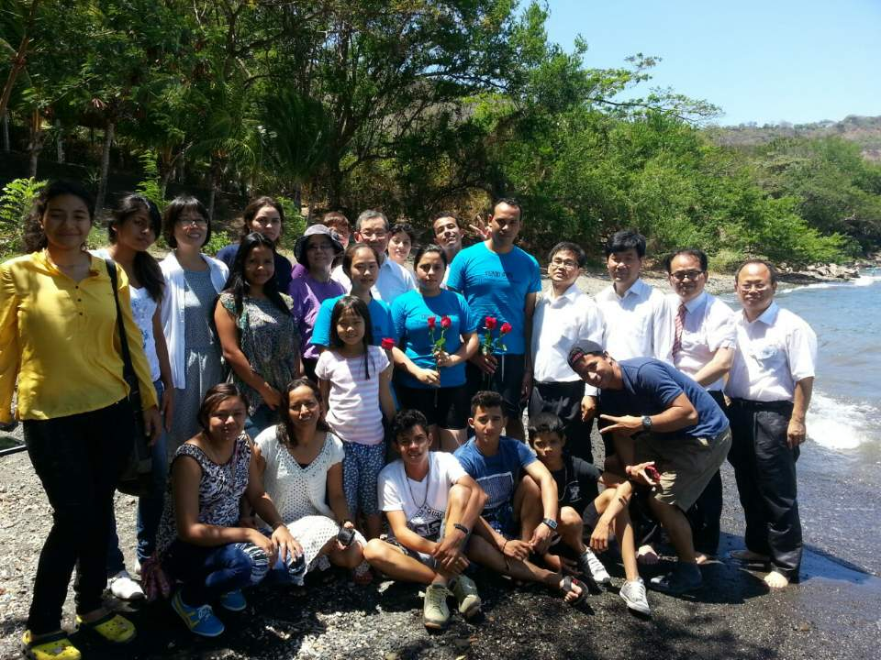
Nicaragua Baptism

Slide 16
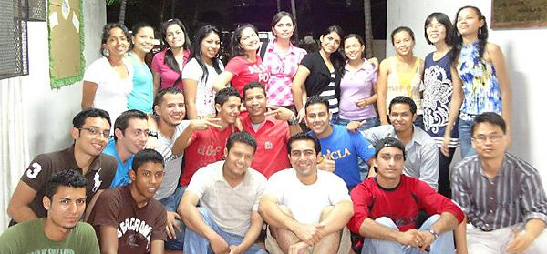
Nicaragua - Baptism

Slide 17
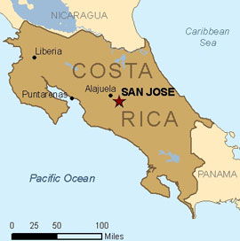

Slide 19
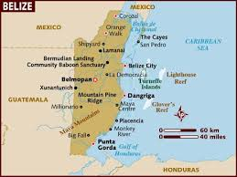

Slide 20
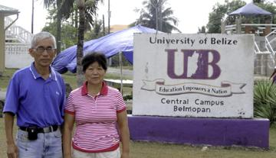

Slide 21
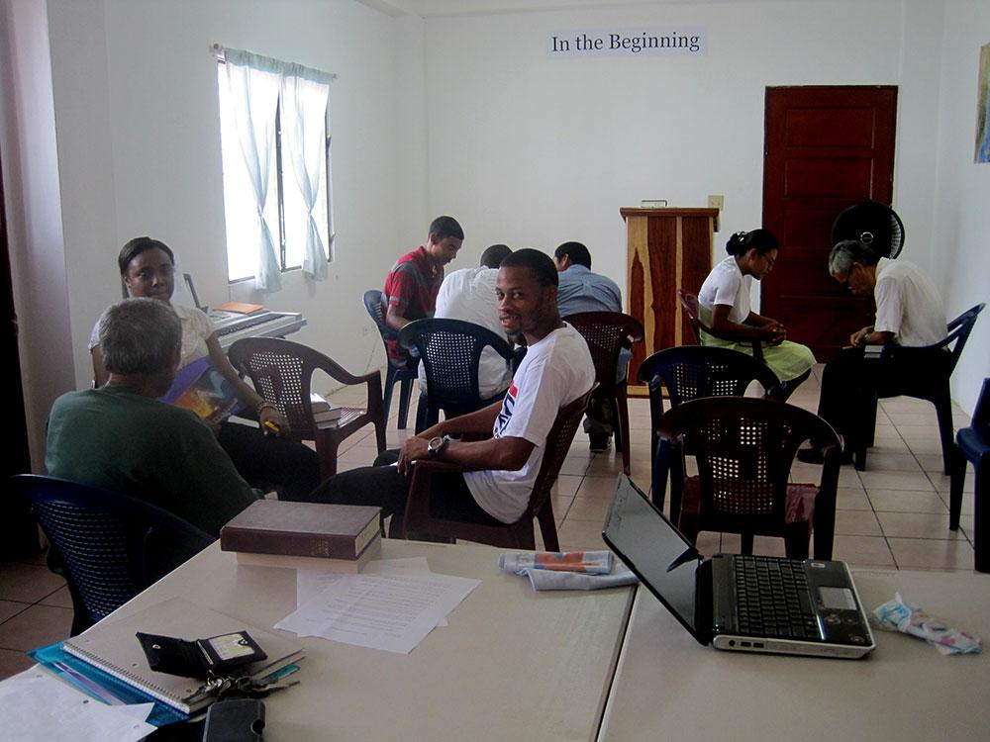

Slide 22
Prayer Topics
Pray that North America may send missionaries to Caribbean countries.
Pray for the evangelization of all of the major cities and campuses of the world in our generations.

