Slide 1
2017 New Year’s Message
LOOK FORWARD TO THE DAY OF GOD
2 Peter 3:1-18

Slide 2
“You ought to live holy and godly lives as you look forward to the day of God and speed its coming.” (3:11b-12a)

Slide 3
Marana Tha!
Come, Lord!

Slide 4
“If anyone does not love the Lord, let that person be cursed! Come, Lord!”
(1Co 16:22)

Slide 5
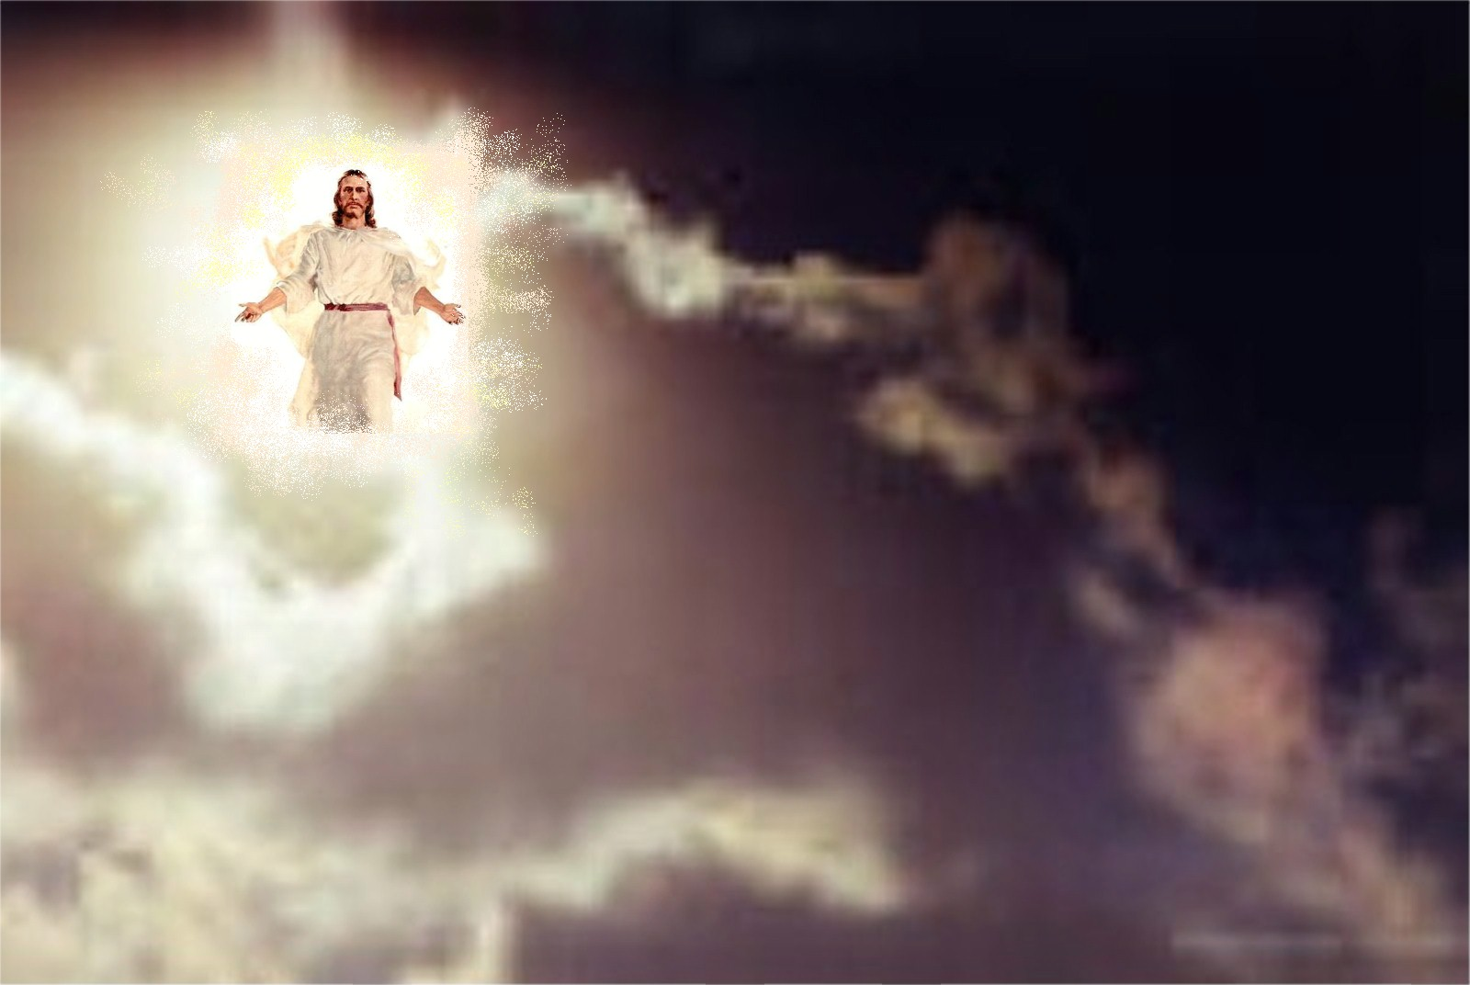

Slide 7
I. THE DAY OF THE LORD WILL COME
(1-7, 10)

Slide 8
“Dear friends, this is now my second letter to you. I have written both of them as reminders to stimulate you to wholesome thinking.”
(1)

Slide 10
“I want you to recall the words spoken in the past by the holy prophets and the command given by our Lord and Savior through your apostles.” (2)

Slide 12
“Above all, you must understand that in the last days scoffers will come, scoffing and following their own evil desires” (3)

Slide 14
“But they deliberately forget that long ago by God’s word the heavens came into being and the earth was formed out of water and by water.” (5)

Slide 16
“Now the earth was formless and empty….and the Spirit of God was hovering over the waters.”
(Gen 1:2)

Slide 18
“By these waters also the world of that time was deluged and destroyed.”
(6)

Slide 19
“ By the same word the present heavens and earth are reserved for fire, being kept for the day of judgment and destruction of the ungodly.” (7)

Slide 20
The Son is the radiance of God’s glory and the exact representation of his being, sustaining all things by his powerful word…. (Heb 1:3)

Slide 22
“But the day of the Lord will come like a thief.” (10a)

Slide 23
“The heavens will disappear with a roar; the elements will be destroyed by fire, and the earth and everything done in it will be laid bare.” (10b)

Slide 24
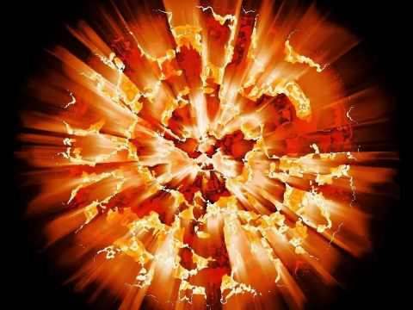

Slide 25
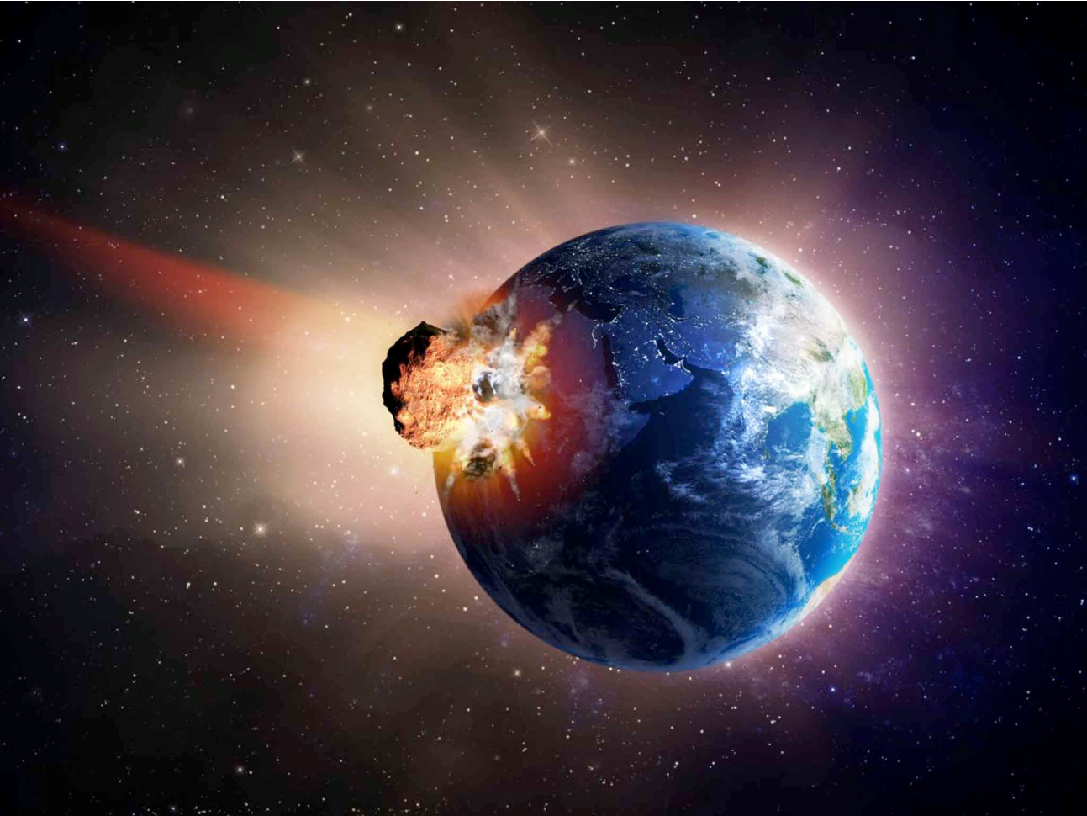

Slide 26
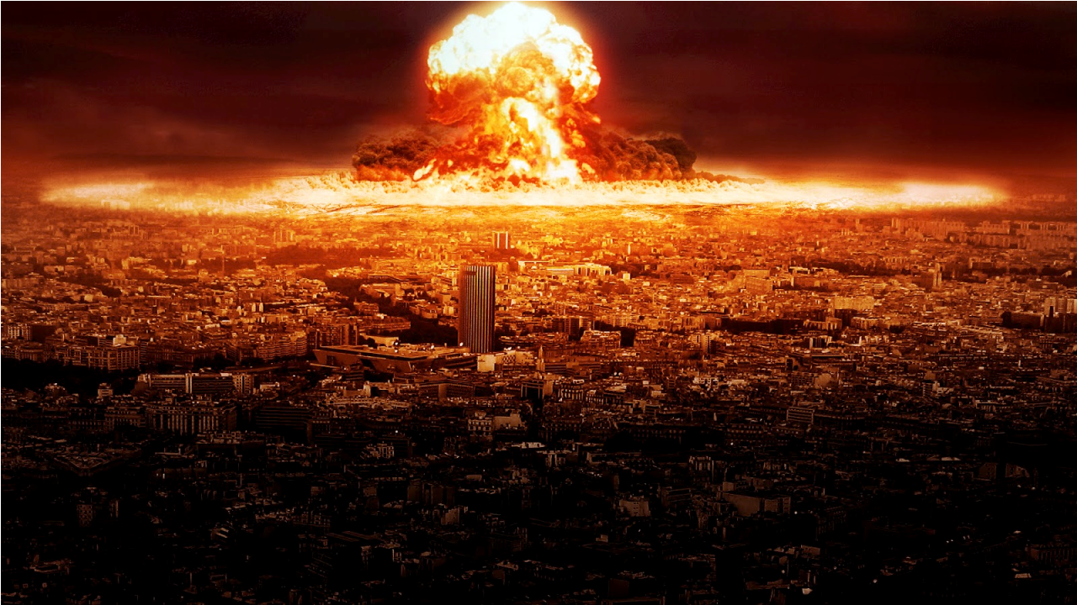

Slide 27
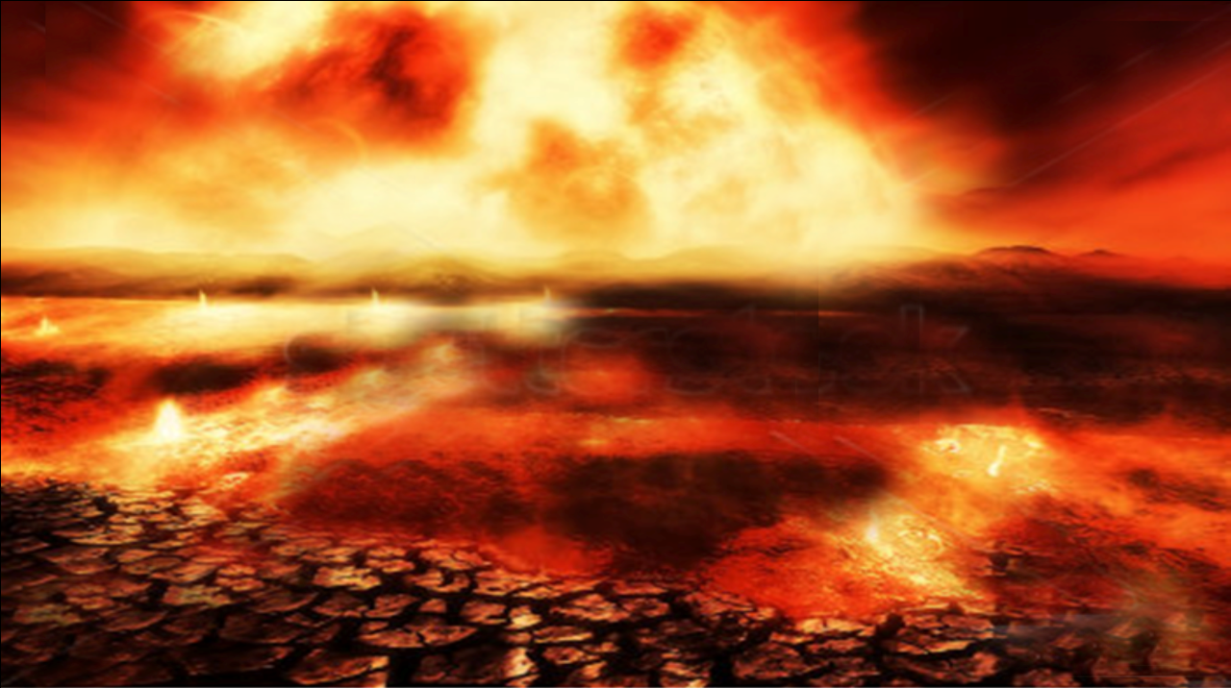

Slide 28
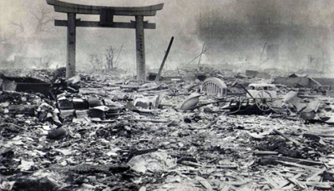

Slide 29
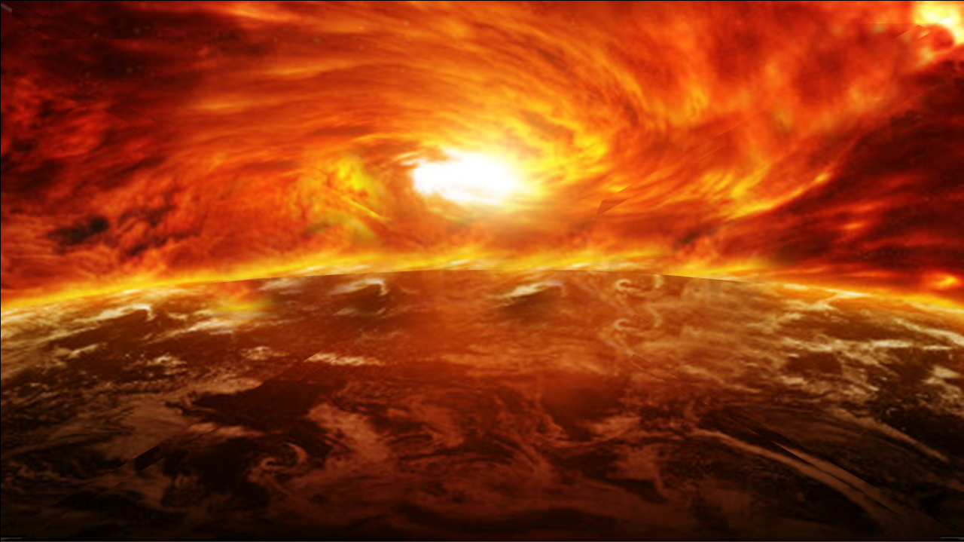

Slide 30
“So you also must be ready, because the Son of Man will come at an hour when you do not expect him.”
(Mt 24:44)

Slide 31
II. What kind of people ought we
to be?
(8-9, 11-18)

Slide 32
“Since everything will be destroyed in this way, what kind of people ought you to be?” (11)

Slide 33
First,
Look forward to the new heaven and the new earth.
(12-13)

Slide 34
“…as you look forward to the day of God and speed its coming.…. But in keeping with his promise we are looking forward to a new heaven and a new earth, where righteousness dwells.” (12-13)

Slide 36
“There will be no more death or mourning or crying or pain, for the older order of things has passed away.”
(Rev 21:4)

Slide 37
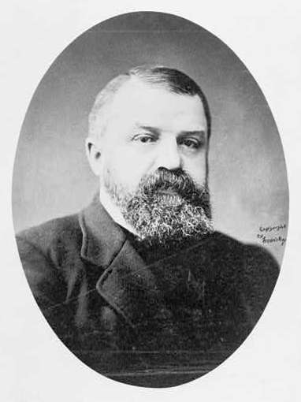
“I have had more
trouble with D.L. Moody
than with any other man
I’ve ever met. If I can
only fix him right, I don’t
have any trouble with
others.” -D.L. Moody-

Slide 38
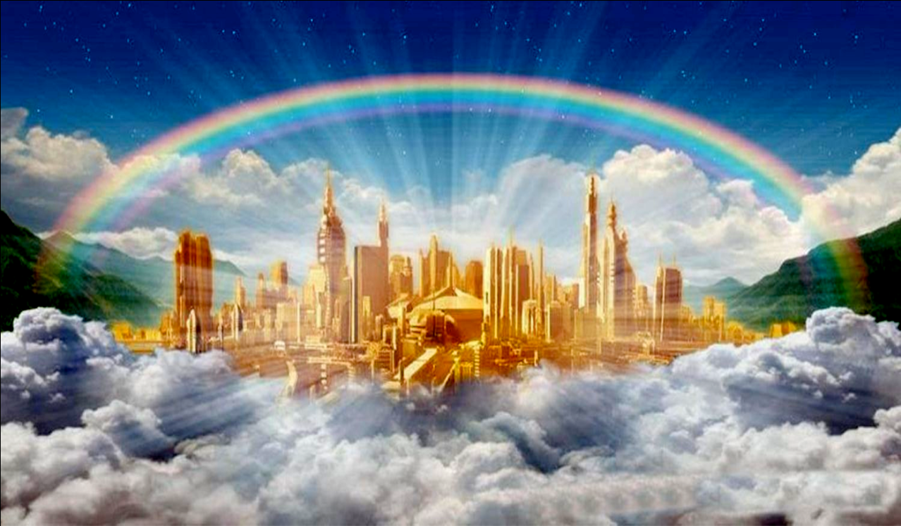

Slide 40
“You will see the Son of Man sitting at the right hand of the Mighty One and coming on the clouds of heaven.”
(Mk 14:62)

Slide 41
“Look, I am coming soon!”
(Rev 22:7,12, 20)

Slide 42
Second,
Live holy and godly lives.
(11b, 14)

Slide 43
“You ought to live holy and godly lives…”
(11b)

Slide 44
“Since you are looking forward to this, make every effort to be found spotless, blameless and at peace with him.”
(14)

Slide 45
“We must all appear before the judgment seat of Christ, so that each of us may receive what is due us for the things done while in the body, whether good or bad.”
(2Co 5:10)

Slide 46
“You were redeemed from the empty way of life…. with the precious blood of Christ.”
(1Pe 1:18-19)

Slide 47
“Therefore, since Christ suffered in his body, arm yourselves also with the same attitude, because whoever suffers in the body is done with sin.”
(1Pe 4:1)

Slide 49
“Now it is required that those who have been given a trust must prove faithful.”
(1Co 4:2)

Slide 50
Third,
Make the most of every opportunity to
share the gospel
(8-9, 15)

Slide 51
“The Lord is not slow in keeping his promise, as some understand slowness. Instead he is patient with you, not wanting anyone to perish, but everyone to come to repentance.” (9)

Slide 52
“Bear in mind that our Lord’s patience means salvation….”
(15)

Slide 53
A.D = The Age of Salvation for all peoples of the world

Slide 54
“And this gospel of the kingdom will be preached in the whole world as a testimony to all nations, and then the end will come”
(Mt 24:14)

Slide 56
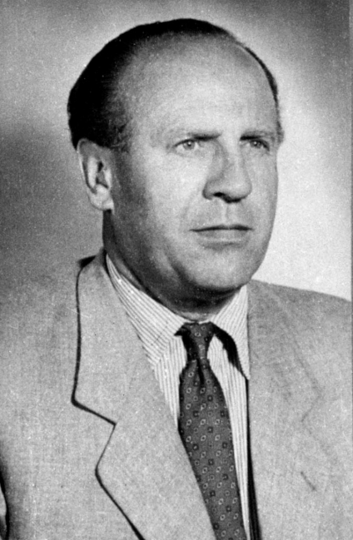
Oskar Shindler (1908-1974)
“I could have got
more out…. I could
have got more…. I
threw away so much money…. I didn’t do enough!”

Slide 57
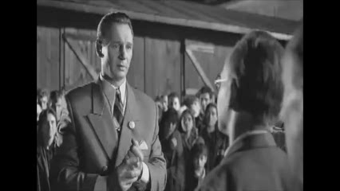

Slide 59
“Grow in the grace and knowledge of our Lord and Savior Jesus Christ” (18)

