Slide 1
2015 Continental Directors Conferences Report (Dec., 2014 – Jan., 2015) by Pastor Abraham Kim

Slide 2
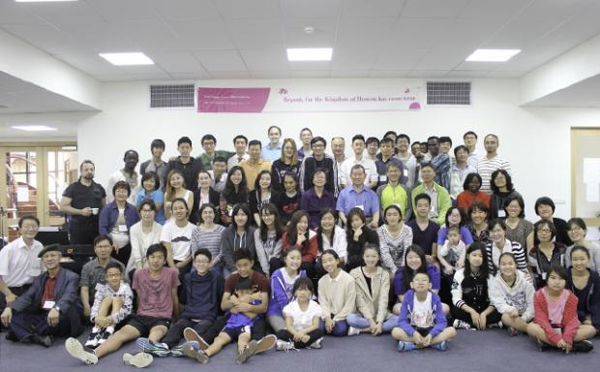
Oceania SBC

Slide 3
Oceania SBC
Held an SBC in 2014 (Missionaries conference and SBC in alternate years).
Raised 2nd-gens, native leaders as messengers
25 college students and graduates attended
Prayer Topic:
Raise native leaders’ house churches

Slide 4
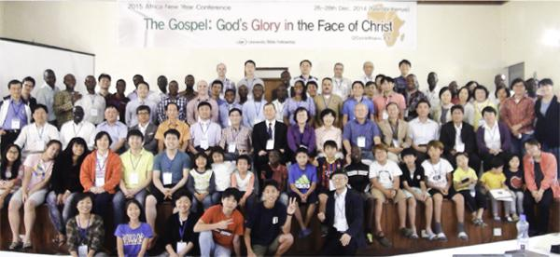
Africa

Slide 5
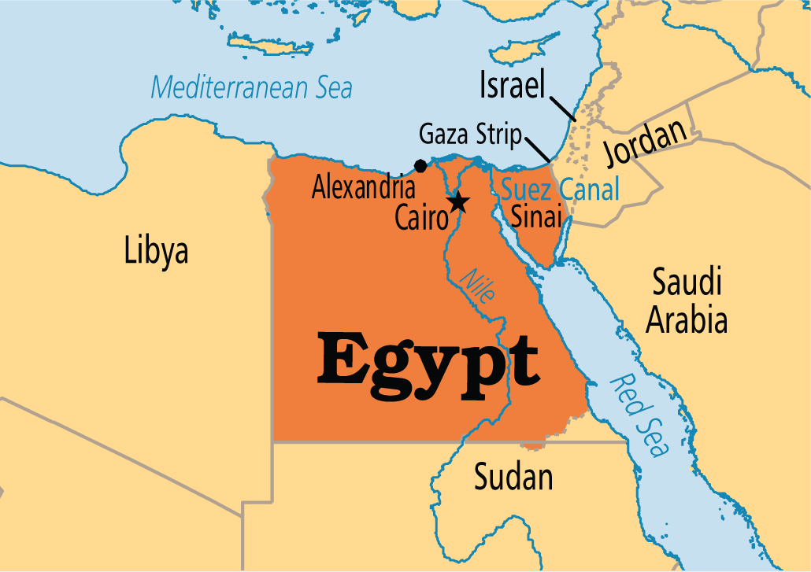
Africa
38 missionaries and 24 native leaders attended.
Mss. Andrew & Hope Kim, Faith Lee are in Egypt.

Slide 6
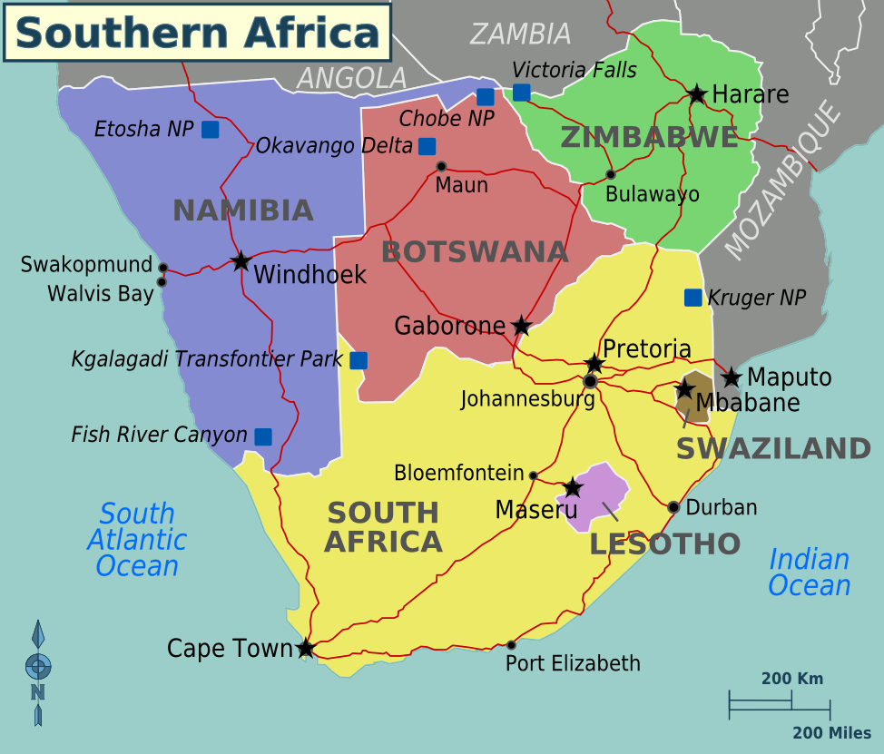
Swaziland
Dr. Samuel Yoo(Uganda) went to Swaziland

Slide 7
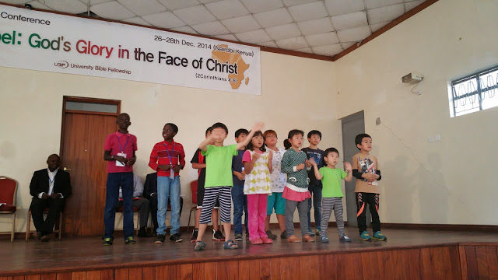
Rosa Yoon (Korea) and Mark/John/Yoon (Kenya, 2nd-gens) served 18 2nd-gens.

Slide 8
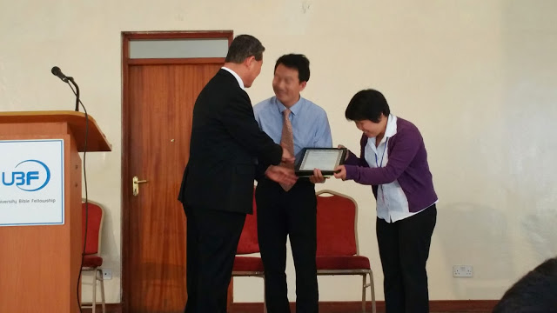
Ordination of David & Abigail Lu (Uganda) as UBF missionaries

Slide 9
Africa Prayer Topics
1. Raise Egypt UBF as missionary base for the Arab countries

Slide 10
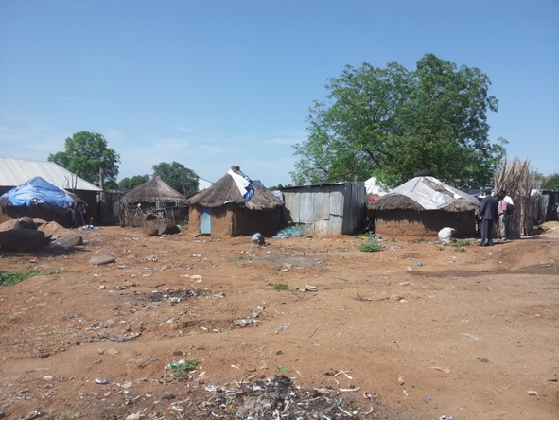
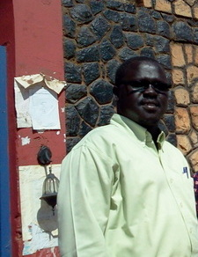
2. South Sudan:
Sh. Padiet Deng to get his company’s HQ office job to serve Juba ministry.
Construction of a Bible House.

Slide 11
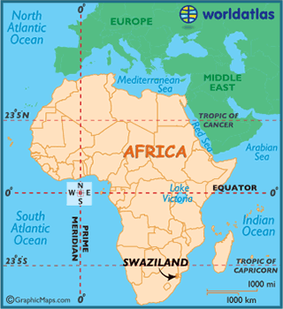
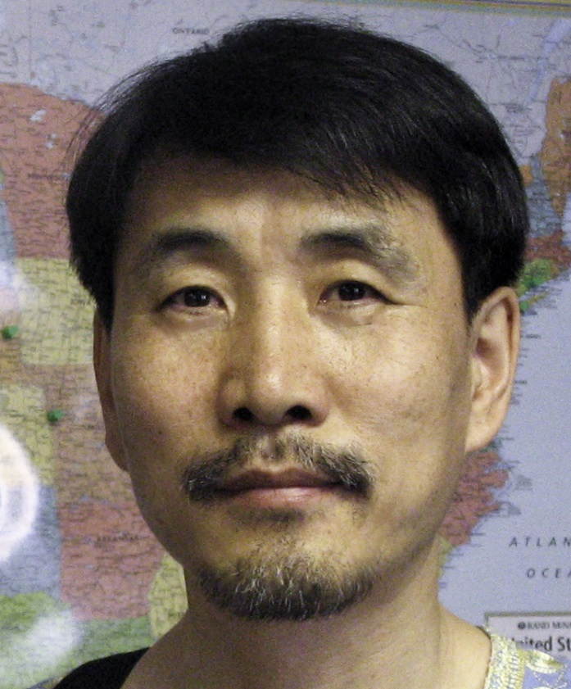
3. Dr. Samuel Yoo
Self-support and pioneering of Swaziland campuses. Uganda Kyambogo chapter - Stewardship of Shep. Julius, Daniel, Katrigume

Slide 12
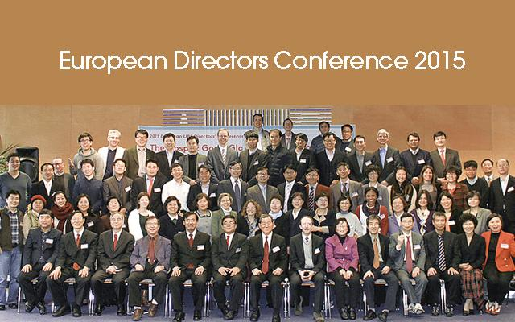
Europe

Slide 13
Europe
Native leaders (Walter Nett, Reiner Schauwienold, Ian Kaier, Paul Ridge) formed a beautiful vessel.
Walter Nett’s 2nd term (2016-2019) supported.
Dr. Henry Park succeeded Dr. Paul Hong as HQ representative.

Slide 14
Europe Prayer Topics
Unity/Coworking – France (Dr. Marc Choi), Serbia (Director--Daniel Ko)
Young Leaders’ conference “Encounter 2015” (college students & graduates; 80+) in July 2015. Pray for developing MBF/HBF conferences.
Dr. Joseph Jin (Norway - complete recovery), Elizabeth Yoon (Serbia - Recovery after cancer treatment), Susanna Cha (U.K - cancer returned)

Slide 15
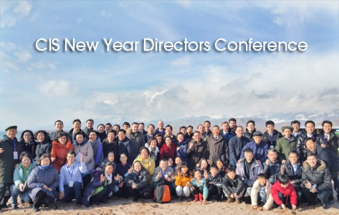
CIS

Slide 16
CIS
Economic depression in Russian and CIS but ministry is growing in most chapters, encouraged by 2014 CIS conference.
Peter Lyu (Mainz, Germany) & Jane Han (NJ, USA) served 10 children.
M. John Lee (Ukraine) served Kazakhstan (Astana, Almaty) leaders with the words of God. (plan to serve Moscow leaders in 2015)
P. Ron served closing message on Lk 24:36-49.

Slide 17
CIS
Next CIS conference in 2019.
Next 2016 directors’ conference in Kiev, Ukraine.
David Lee (Yekaterinburg) was recommended as next term (2016-2019) CIS coordinator (If he doesn’t accept, M. David Byun will serve a second term).

Slide 18
CIS Prayer Topics
Restoration of God’s church along the ancient Silk Road in Central Asia (Kazakhstan, Kyrgyzstan, Uzbekistan, Tajikistan)
Continuing staff training of Russia & Central Asian native leaders
2nd-gen conference in Moscow in July 2015

Slide 19
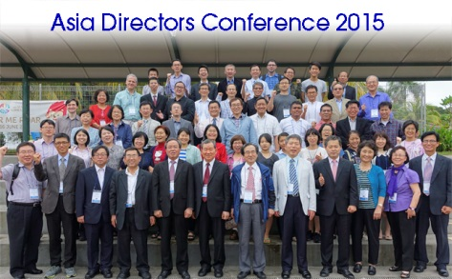
ASIA

Slide 20
ASIA
26 missionaries and 13 native leaders attended. Ison Hong & Vincent Lee (Malaysia) first attended.
P. Mark Vucekovich, Drs. James & Sarah Kim
(USA) attended.
China women missionaries had a conference in 2014 in Korea. Korea will host China missionaries (both men & women; 42 in 20 chapters) conference every other year (next conference in 2016).

Slide 21
ASIA
Expenses for China missionaries conferences will be supported by HQ/Korea.
M. Peter Lee (Indonesia) succeeded M. Daniel Jeong (Japan) as Asia coordinator.

Slide 22
ASIA Prayer Topics
China and North Korea - China government works toward evacuating all foreign missionaries by 2017
Staff training for Philippines UBF (7 chapters)
Self-support: M. Peter & Deborah Lee (Thailand), Do-Yoel Lee (Cambodia)
Joseph Song (China), Marie Kim, Anna Lee, Hengky (Indonesia) to overcome cancer.

Slide 23
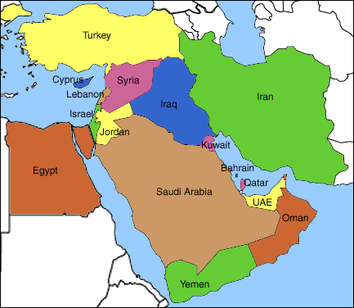
MIDDLE EAST
P.t & R. L. (Turkey) & P. M. V. attended.

Slide 24
ME Prayer Topics
Raise disciples among students with Christian background
N. Y. (Libya) - protection and ministry in the midst of civil war
Joseph Kim (Qatar) - to successfully complete ongoing construction project by June 2015
B.-S. & R. P. (KSA)- self-support.
3. P. K. (Pakistan) - ministry direction

Slide 25
Latin America ISBCs 2015:
Southern Latine America Region (Jan. 15-18 in Argentina) - 121 from 7 countries attended.
Missionaries and native leaders showed unity
and communication. Many native leaders and
Bible students saved money for months to
attend the conference.

Slide 26
Latin America ISBCs 2015:
Mexico Region (April 3-5 in Mexico City)
Central America Region (April 3-5 in Guatemala)
Northern L.A. Region (August 20-23 in Venezuela) - pray for stability of Venezuela

